Slide 1
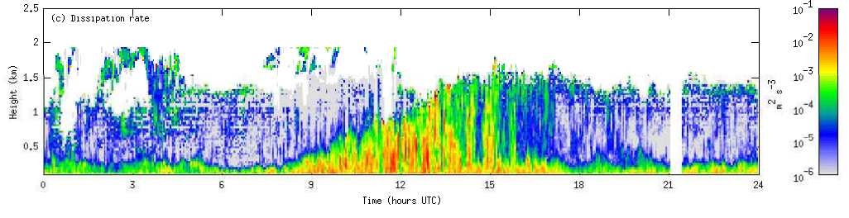
Ground-based profiling of Clouds,
Aerosol, Winds and Turbulence
Ewan O’Connor
FMI (Finnish Meteorological Institute), Helsinki, Finland

Slide 2
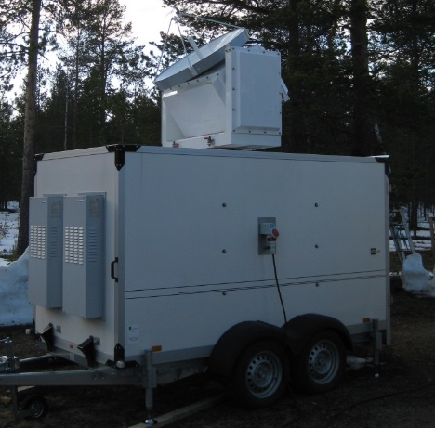
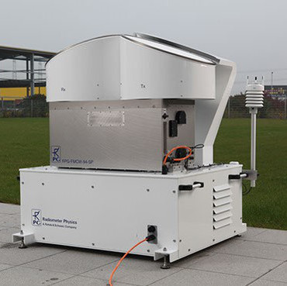
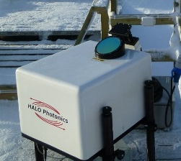
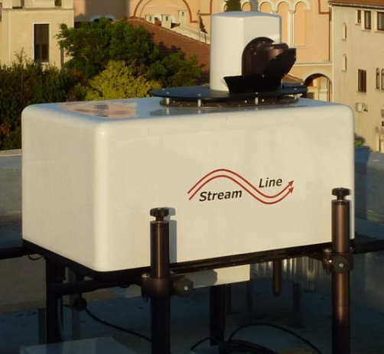
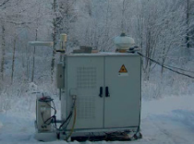
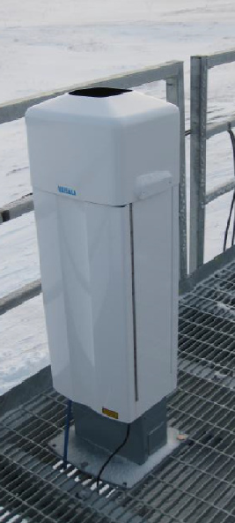
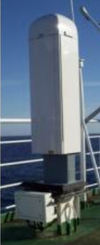
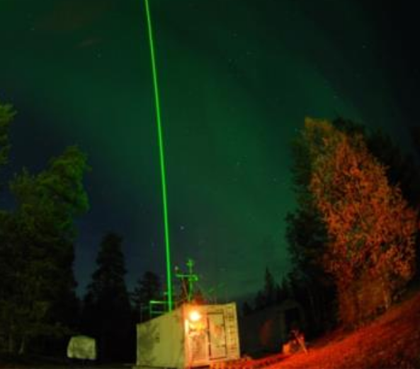
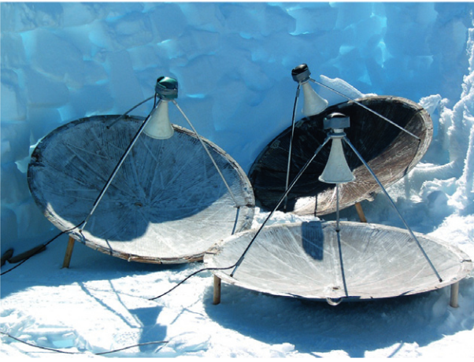
Profiling capability in Finland
Cloud radar: 240-600 k€
Doppler lidar: 200-300 k€
Multi-λ lidar: > 200 k€
Ceilometer: <30 k€
Sodar: 30 k€

Slide 3
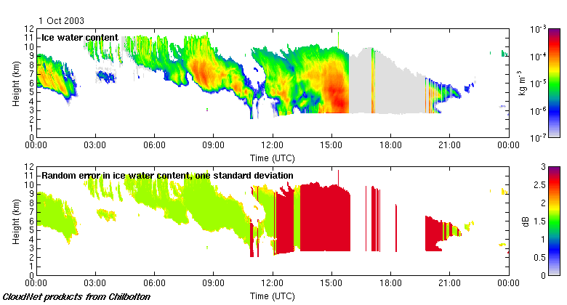
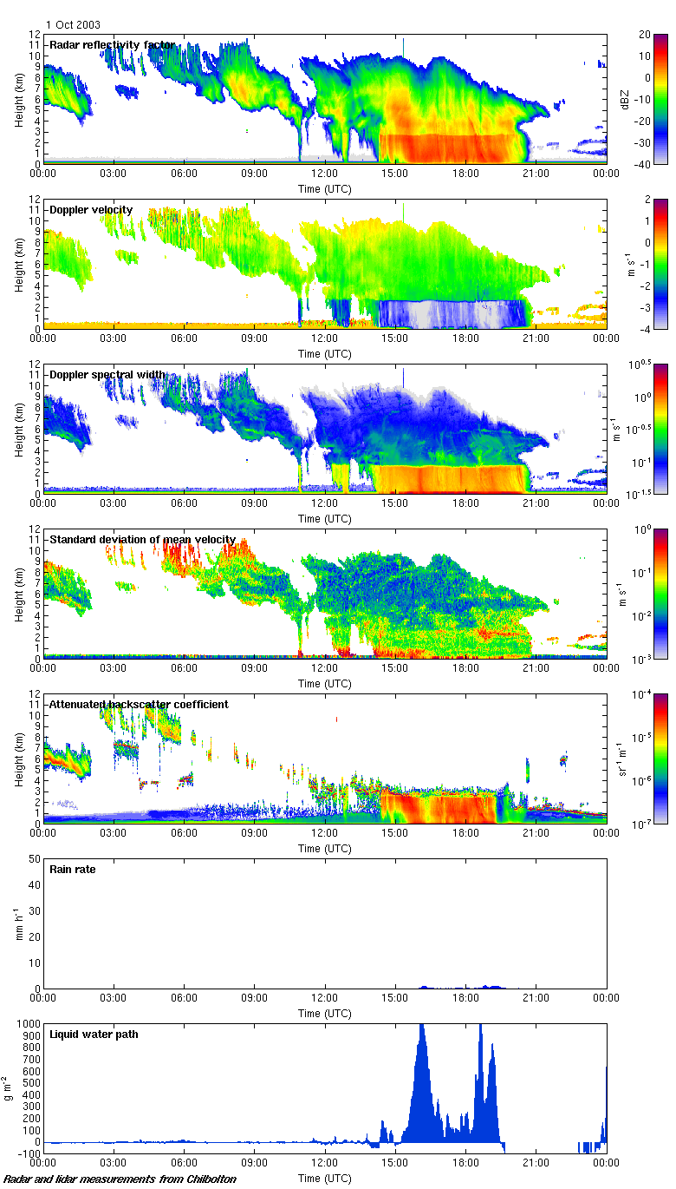
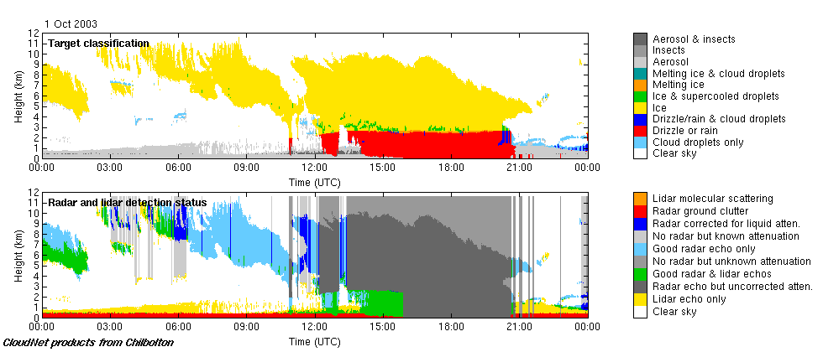
Doppler cloud radar
Vertically-pointing (can scan)
  Usually combine with lidar and microwave radiometer
Ice
Note larger error above melting-layer due to uncertain attenuation
IWC not reported if rain at ground
Radar
Lidar
Liquid
Rain
Aerosol
Liquid, ice, precipitation microphysical properties
Turbulent properties

Slide 4
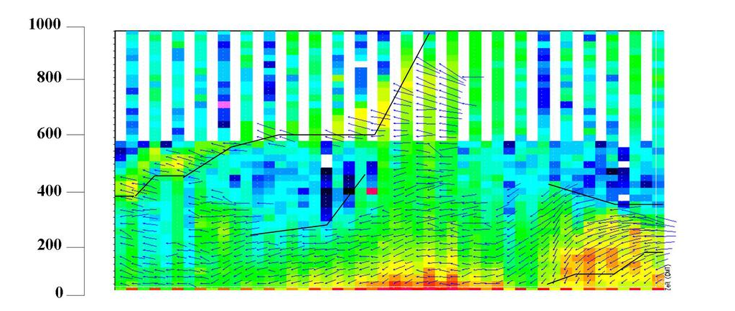
Provide winds and turbulent parameters in the boundary layer
Doppler lidar, sodar

Slide 5
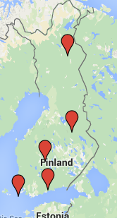
FMI has 7 Doppler lidars
5 in an operational network
2 for campaigns
Products also include:
Wind shear
Low level jets
Mixing level height
BL classification
Wind gusts
Doppler lidar

Slide 6
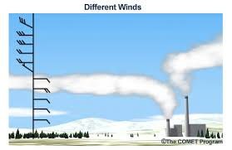
Wind shear

Slide 7
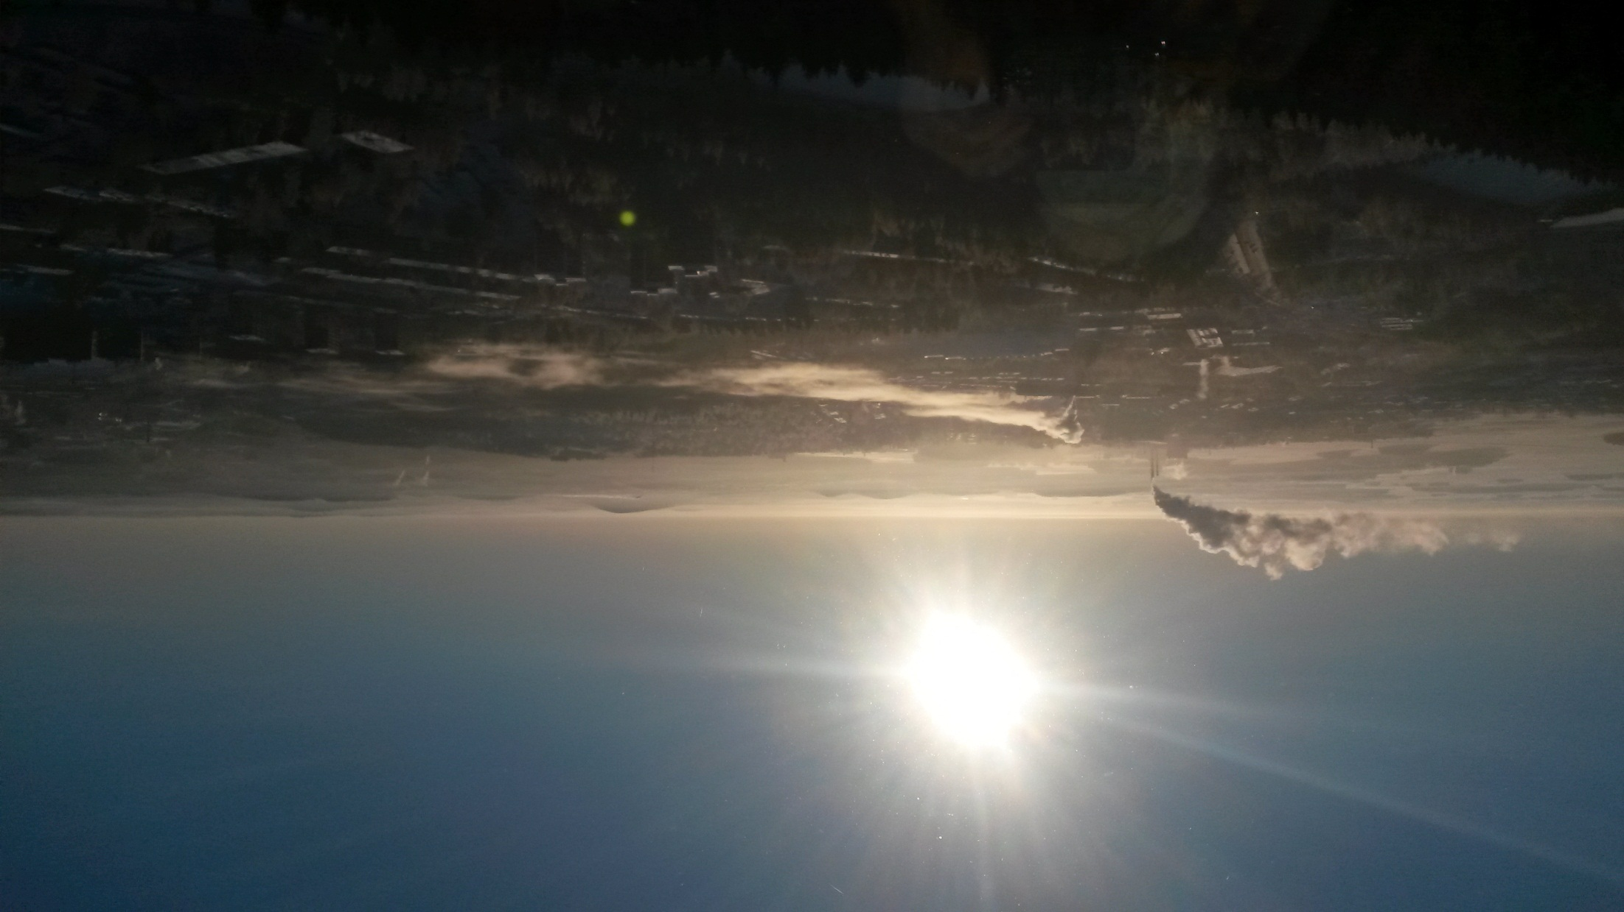
Plume observations - Kuopio

Slide 8
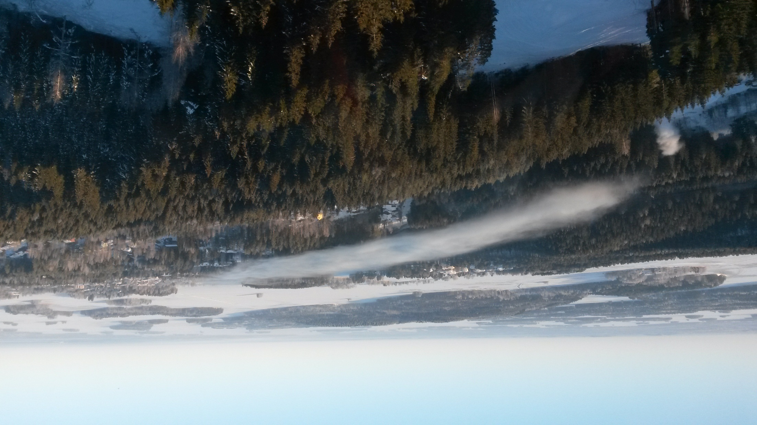
Plume observations - Kuopio

Slide 9
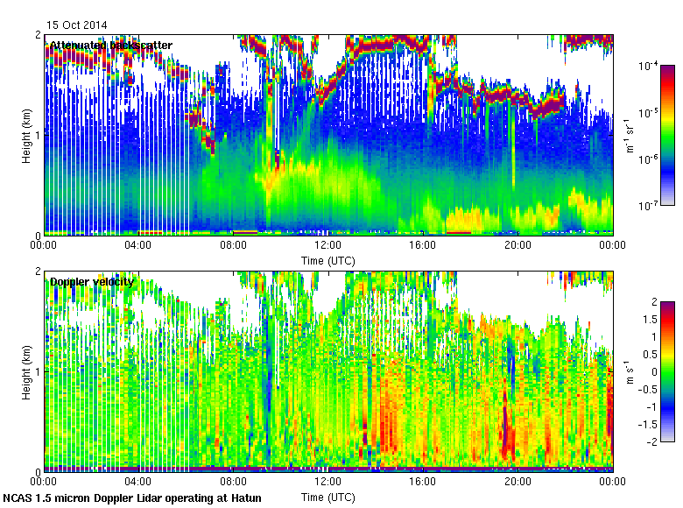
Re-suspended ash/dust – NCAS DL at Hatun (Iceland)
Elevated dust
Local dust being lofted

Slide 10
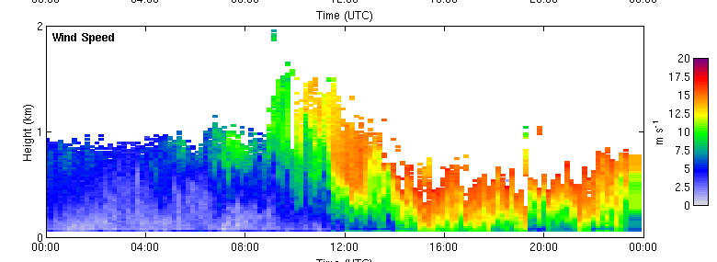
Re-suspended ash/dust – NCAS DL at Hatun (Iceland)

Slide 11
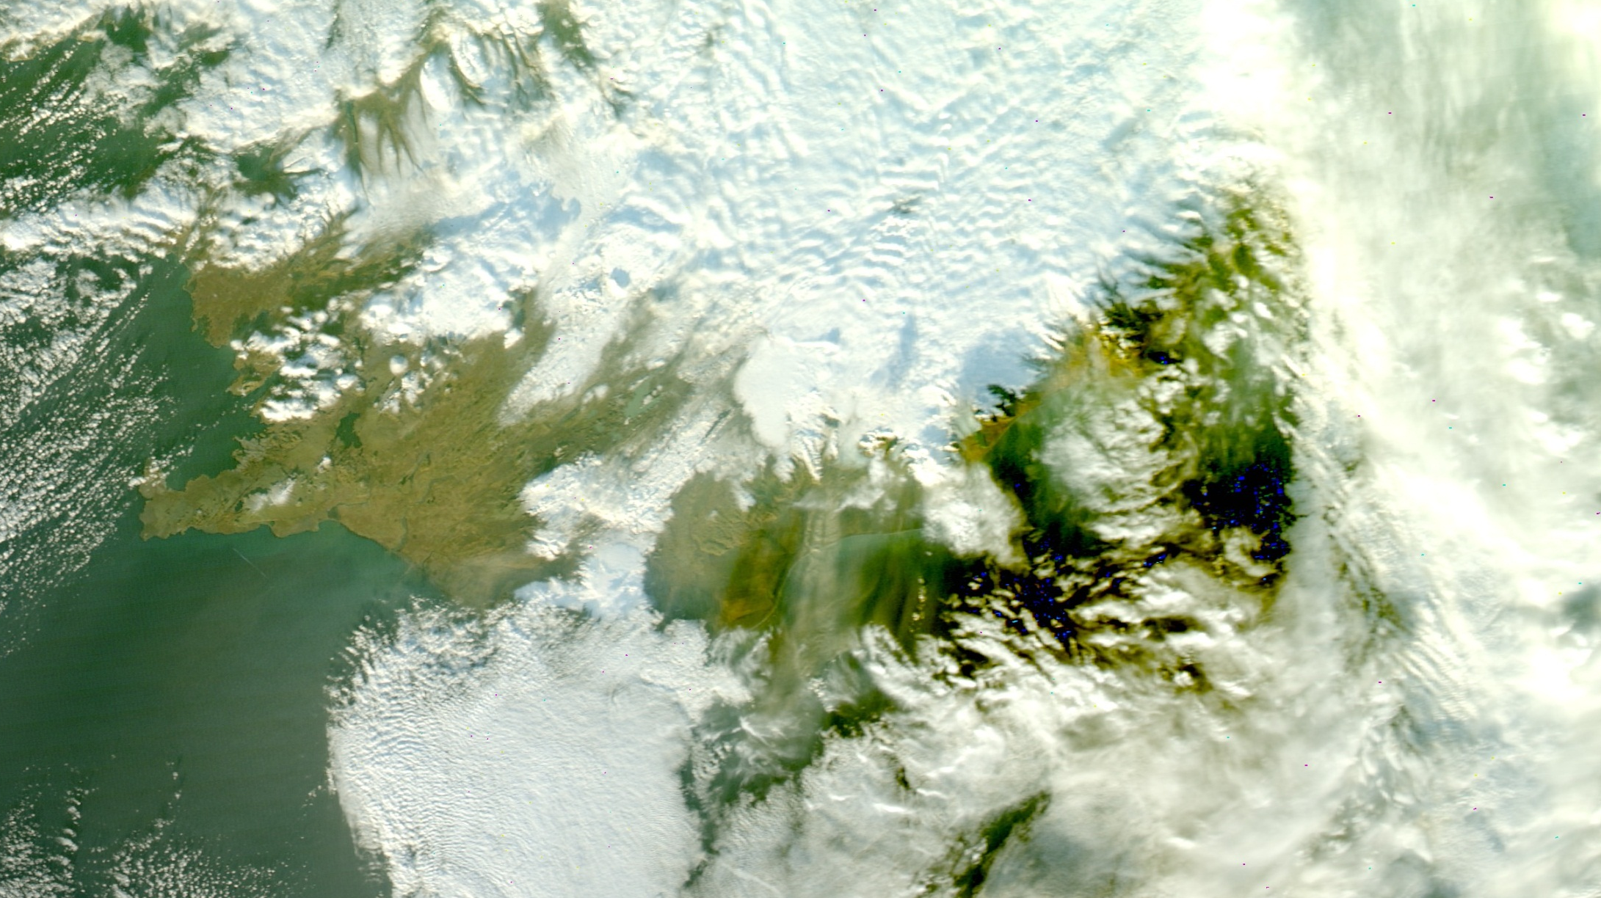

Re-suspended ash/dust

Slide 12
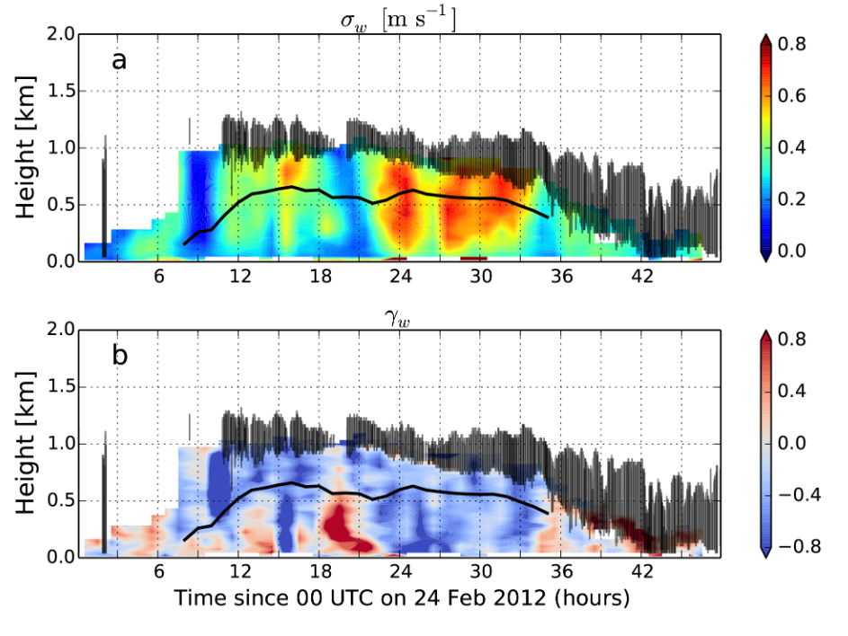
Marine Stratocumulus

Slide 13
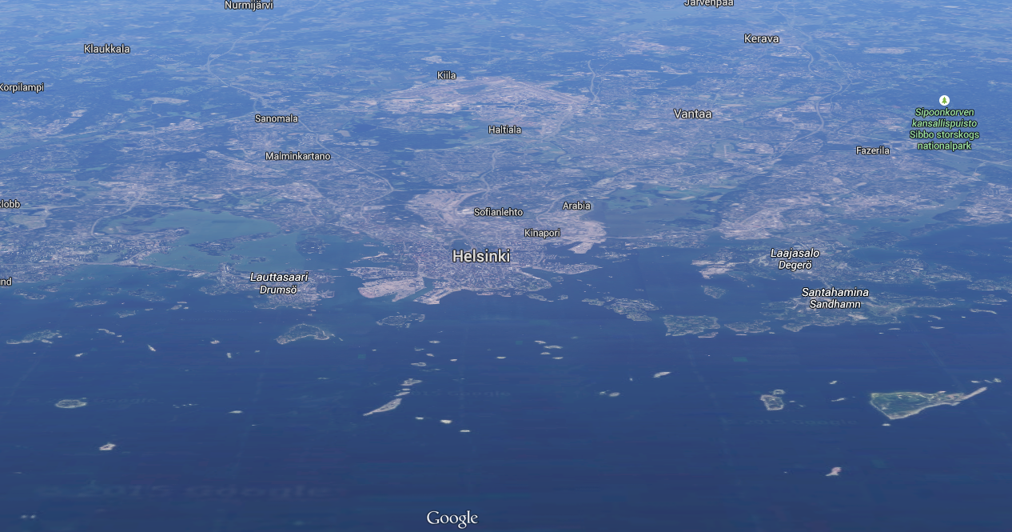
Advection of mixed layers in coastal regions
Example from Helsinki

Slide 14
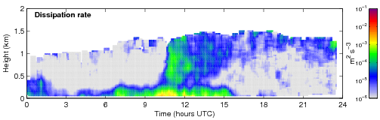
Advection of mixed layers in coastal regions
Example from Helsinki

Slide 15
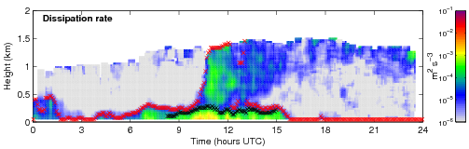
Advection of mixed layers in coastal regions
Example from Helsinki
Marine Boundary Layer
Land Boundary Layer

Slide 16
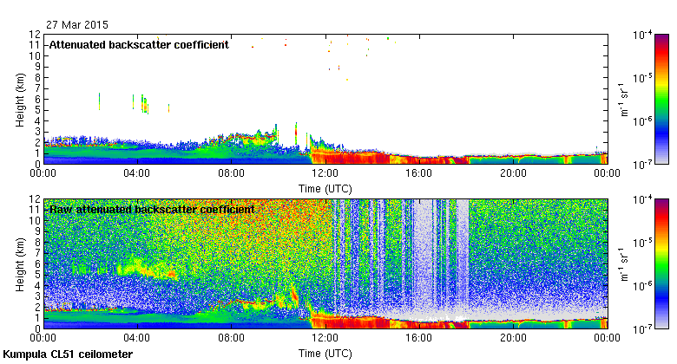
Originally designed to measure cloud base
Can do so much more!
Ceilometer
Elevated aerosol
Liquid layer
Supercooled liquid
Drizzle
Ice
Rain

Slide 17
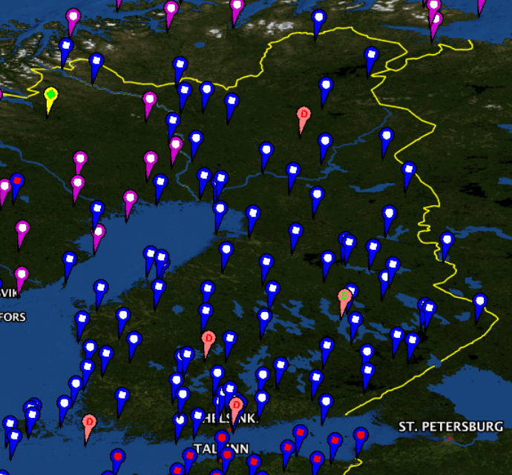
Finnish network – 8 providing profiles
> 50 operating
Cloud base
Cloud phase
Precipitation
Icing potential
Ceilometer

Slide 18
Multi-λ lidar
Powerful lasers and multiple channels
  Measure
    aerosol extinction profiles directly
    humidity profile
    depolarisation ratio
  Combination can provide
    aerosol mass
    aerosol type
  Sensitive enough to detect high cirrus
    If no intervening cloud
    May even detect Polar Stratospheric Clouds

Slide 19
What can we measure why does the vertical profile matter?
Nowcasting, forecasting, climate prediction
What can we measure
  Measure
    aerosol extinction profiles directly
    humidity profile
    depolarisation ratio
  Combination can provide
    aerosol mass
    aerosol type
  Sensitive enough to detect high cirrus
    If no intervening cloud
    May even detect Polar Stratospheric Clouds

Slide 20
What is available in Finland
Nowcasting, forecasting, climate prediction
Science and applications

Slide 21
Forecast and climate models
  Accurate cloud and aere
    aerosol extinction profiles directly
    humidity profile
    depolarisation ratio
  Combination can provide
    aerosol mass
    aerosol type
  Sensitive enough to detect high cirrus
    If no intervening cloud
    May even detect Polar Stratospheric Clouds

Slide 22
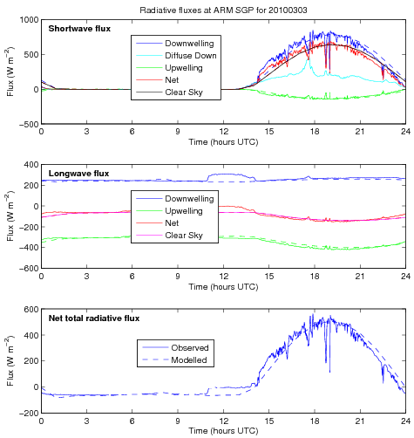
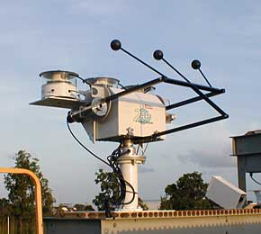
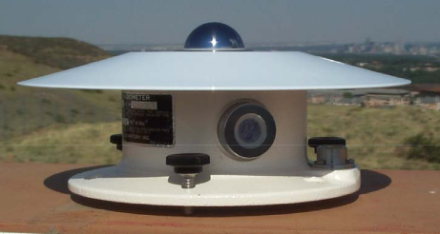
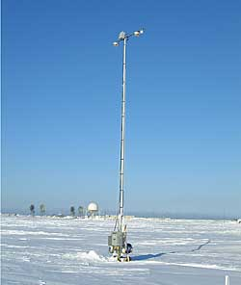
Surface radiative fluxes

Slide 23
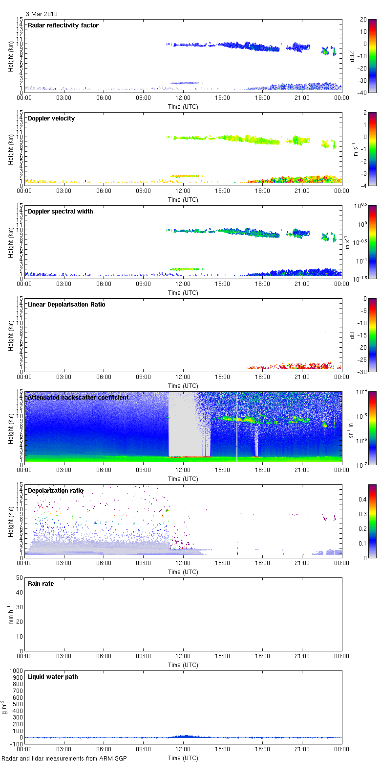

Slide 24
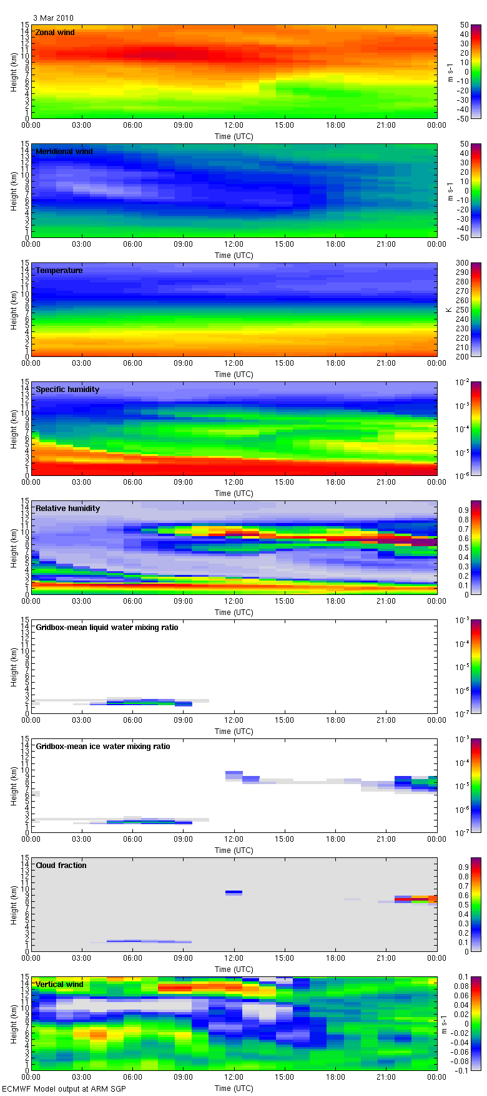
ECMWF forecast model

Slide 25
Surface radiative fluxes

Slide 26
Good
agreement!

Slide 27
Impact of
liquid layer

Slide 28
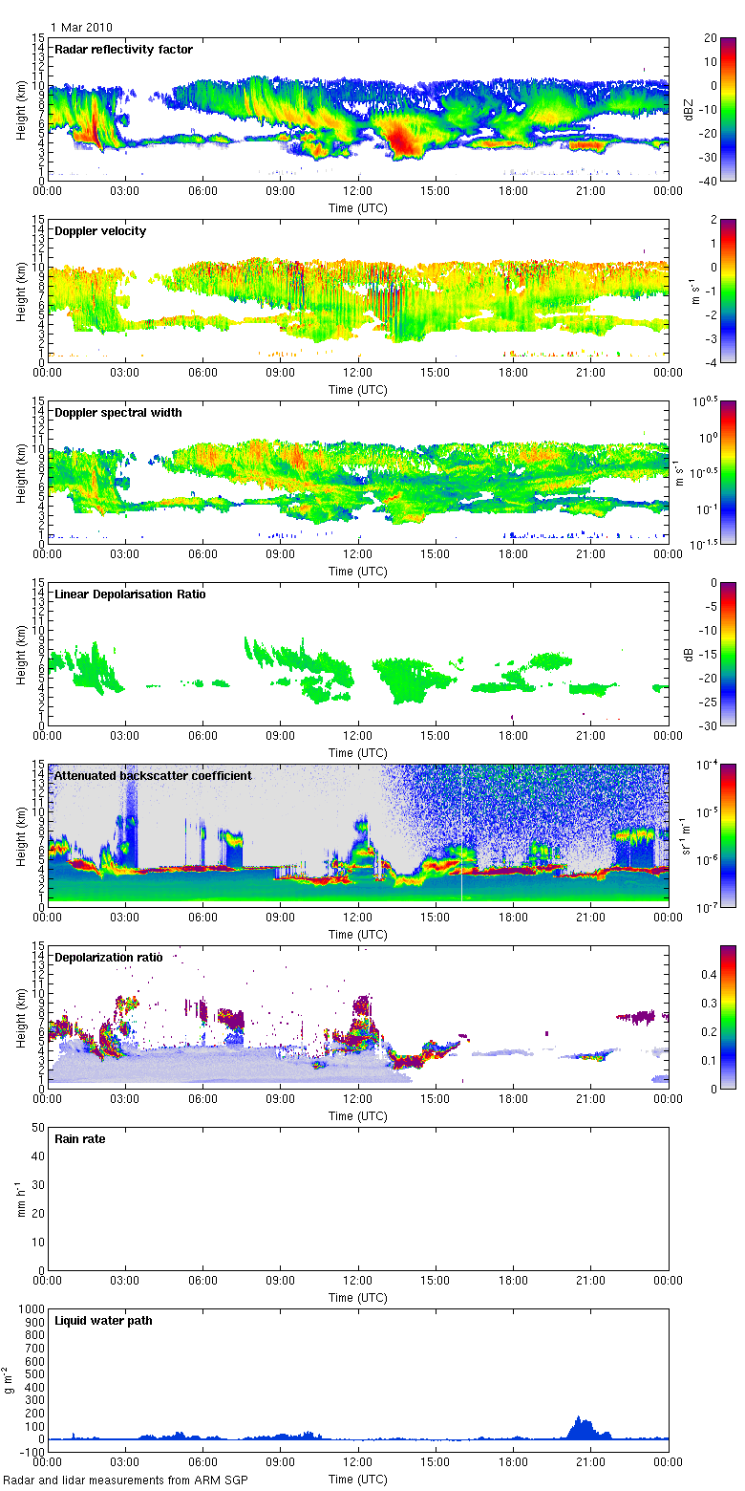

Slide 29
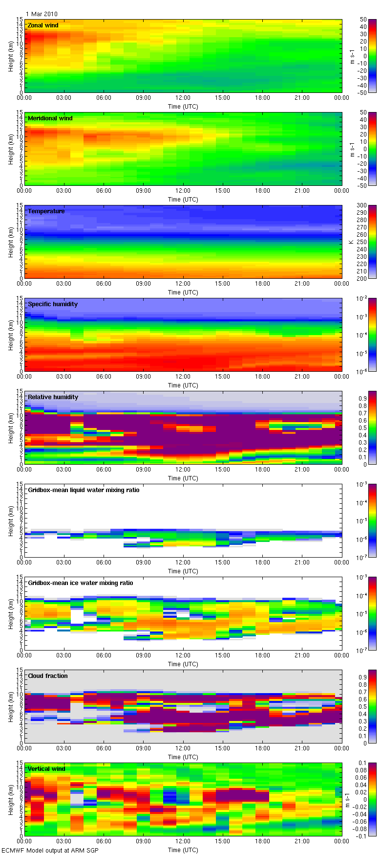
ECMWF forecast model

Slide 30
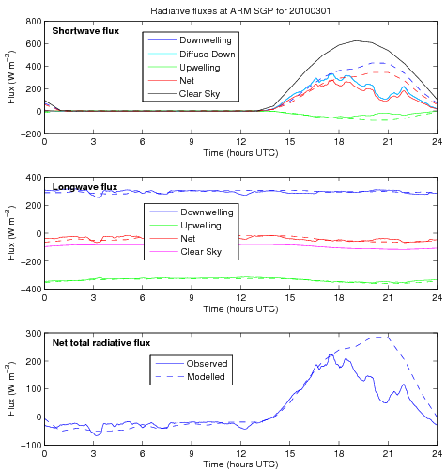
Radiative fluxes

Slide 32
Significant
liquid layer

Slide 33
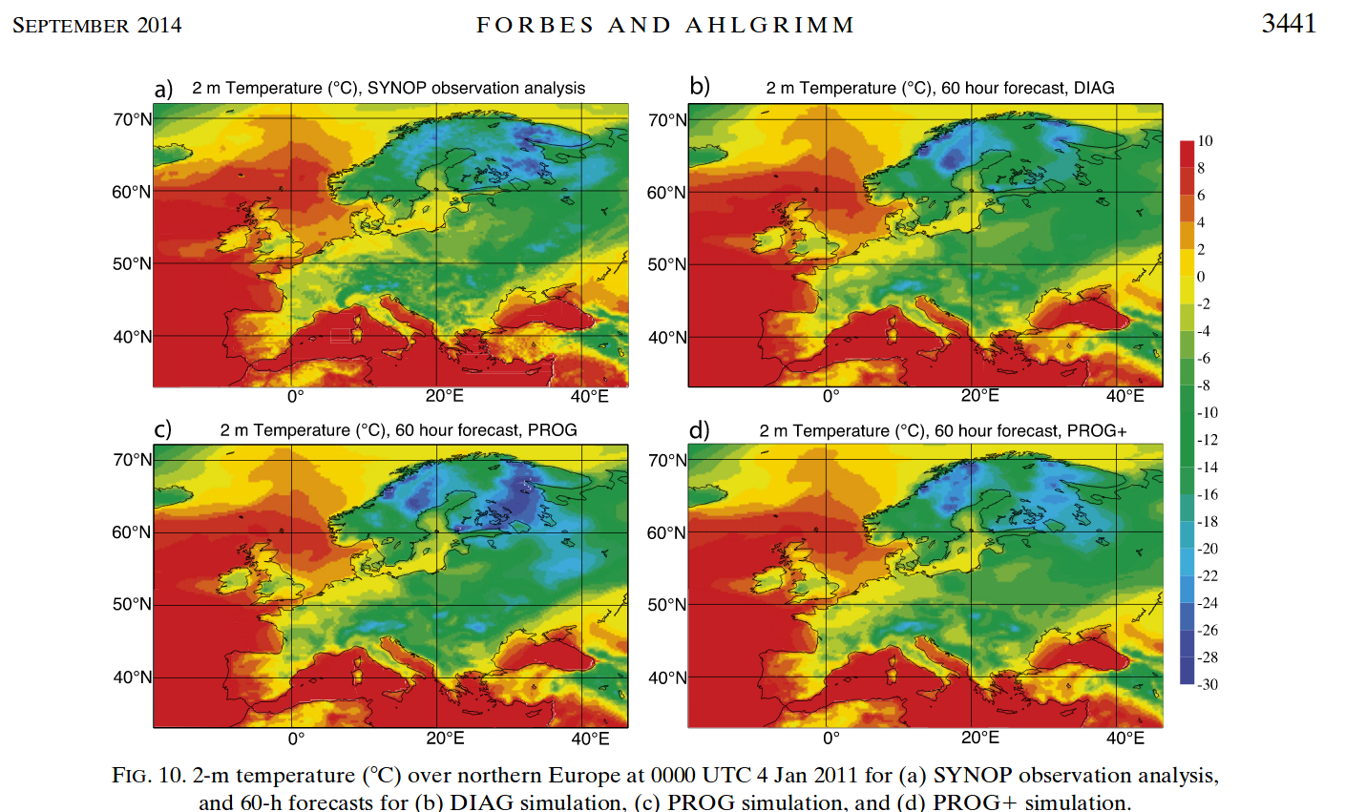
Applications: ECMWF cloud scheme
Observations
Old cloud scheme
Too warm in Lapland

Slide 34
Applications: ECMWF cloud scheme
New cloud scheme
Too cold in Lapland

Slide 35
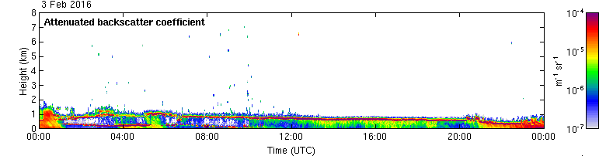
Applications: ECMWF cloud scheme
Ceilometer data: supercooled liquid layers
Optical depth > ice
Model forecast
Old scheme - too much supercooled liquid
distributed in a thick layer
Prognostic scheme - ice-only layers
New prognostic scheme - ‘realistic’ supercooled layers

Slide 36
Applications: ECMWF cloud scheme

Slide 37
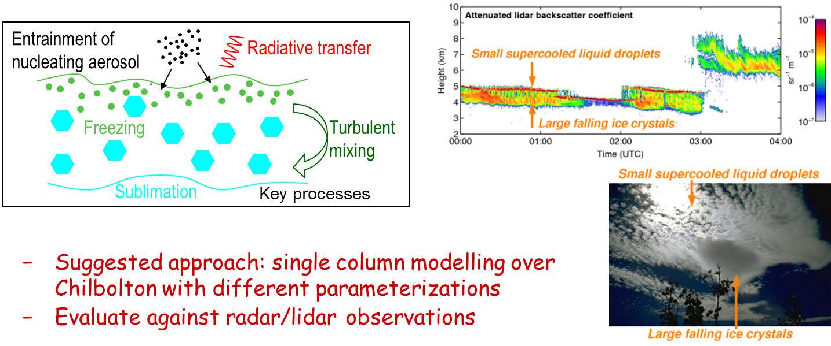
Synergy – combine clouds, aerosol, turbulence
Mixed-phase clouds

Slide 38
Wide variety of ground-based profiling instruments in Finland
  Many are state-of-the-art
  Colocation enables synergy
High resolution profiling of
  Clouds, Aerosol, Winds, Turbulence..
Suitable for
  Process studies
  Model assimilation and evaluation
  Nowcasting and forecasting
Most products will be available in NRT

