Slide 1
Enhancing Finland’s ceilometer network

Slide 2
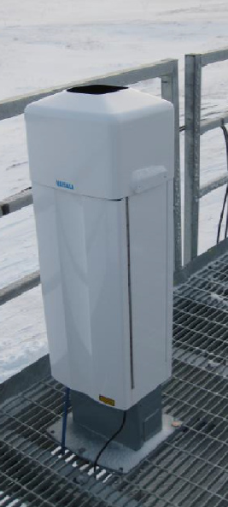
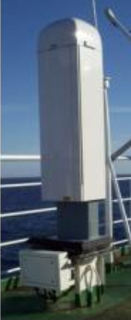
Ceilometer
Ceilometer: <30 k€
Solid-state laser
Resolution:
<30 m vertical
<30 s time
Provide:
Cloud base
Cloud coverage

Slide 3
Ceilometer
Ceilometer: <30 k€
Solid-state laser
Resolution:
<30 m vertical
<30 s time
Provide:
Cloud base
Cloud coverage
Signal

Slide 4
Ceilometer
Ceilometer: <30 k€
Solid-state laser
Resolution:
<30 m vertical
<30 s time
Provide:
Cloud base
Cloud coverage
Signal

Slide 5
Ceilometer
Ceilometer: <30 k€
Solid-state laser
Resolution:
<30 m vertical
<30 s time
Provide:
Cloud base
Cloud coverage
Signal

Slide 6
Ceilometer
Ceilometer: <30 k€
Solid-state laser
Resolution:
<30 m vertical
<30 s time
Provide:
Cloud base
Cloud coverage
Signal

Slide 7
Ceilometer
Ceilometer: <30 k€
Solid-state laser
Resolution:
<30 m vertical
<30 s time
Provide:
Cloud base
Cloud coverage
Signal

Slide 8
Ceilometer
Ceilometer: <30 k€
Solid-state laser
Resolution:
<30 m vertical
<30 s time
Provide:
Cloud base
Cloud coverage
Signal

Slide 9
Ceilometer
Ceilometer: <30 k€
Solid-state laser
Resolution:
<30 m vertical
<30 s time
Provide:
Cloud base
Cloud coverage
Signal

Slide 10
Ceilometer
Ceilometer: <30 k€
Solid-state laser
Resolution:
<30 m vertical
<30 s time
Provide:
Cloud base
Cloud coverage
Signal

Slide 11
Ceilometer
Ceilometer: <30 k€
Solid-state laser
Resolution:
<30 m vertical
<30 s time
Provide:
Cloud base
Cloud coverage
Signal

Slide 12
Ceilometer
Ceilometer: <30 k€
Solid-state laser
Resolution:
<30 m vertical
<30 s time
Provide:
Cloud base
Cloud coverage
Very robust!

Slide 13
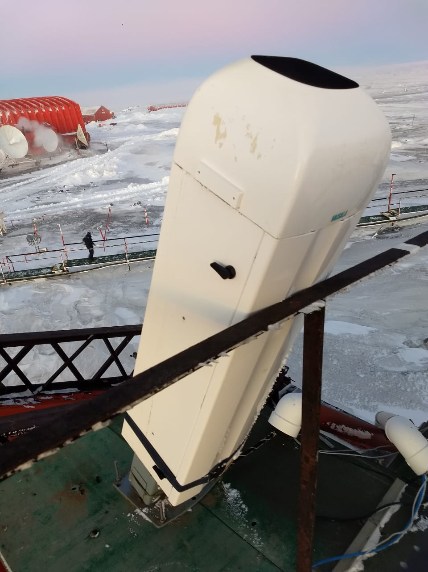
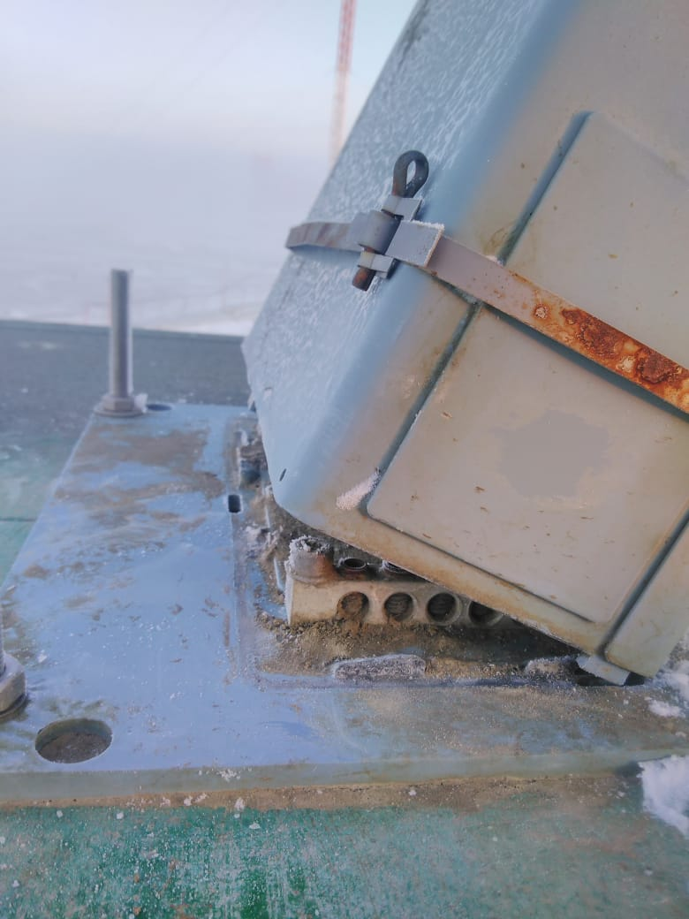
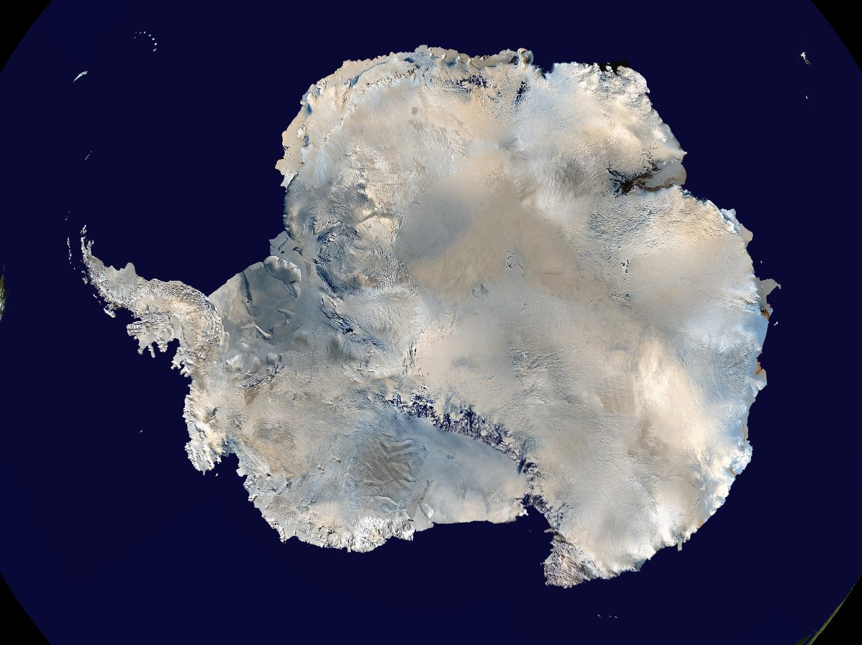
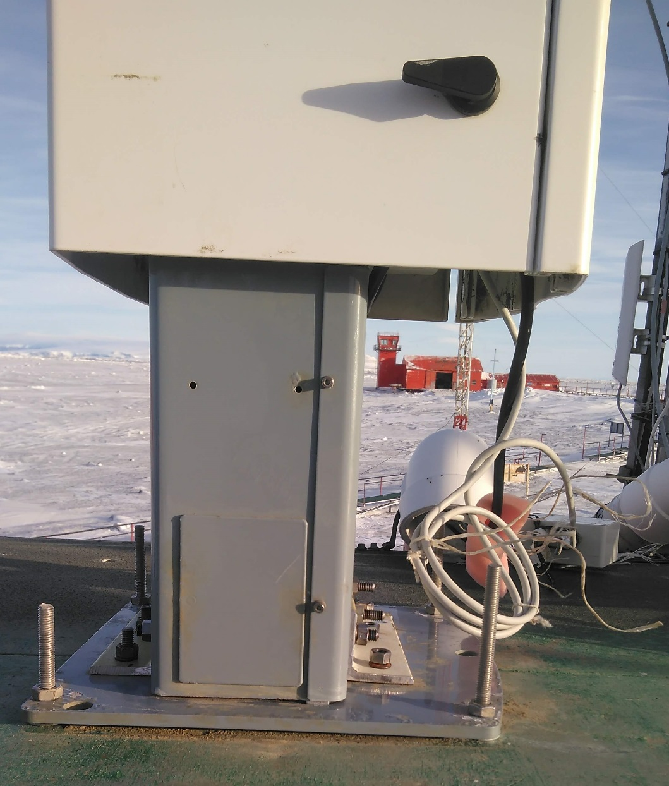
Marambio
Ceilometer

Slide 14
Originally designed to measure cloud base Can do so much more!
Ceilometer
Elevated aerosol
Liquid layer
Supercooled liquid
Drizzle
Ice
Rain

Slide 15
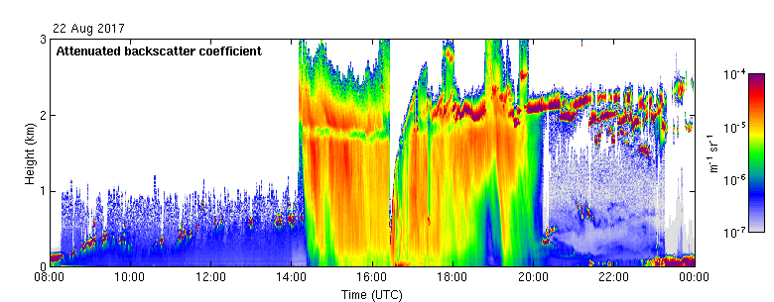
Melting layer detection

Slide 16
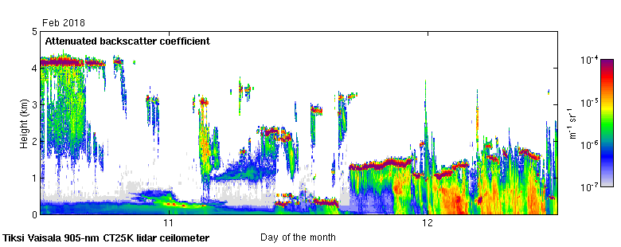
Ceilometer classification

Slide 17
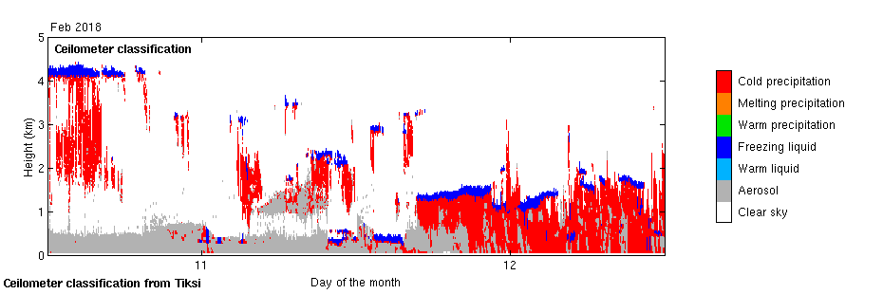
Ceilometer classification

Slide 18
Mixed-phase clouds

Slide 19
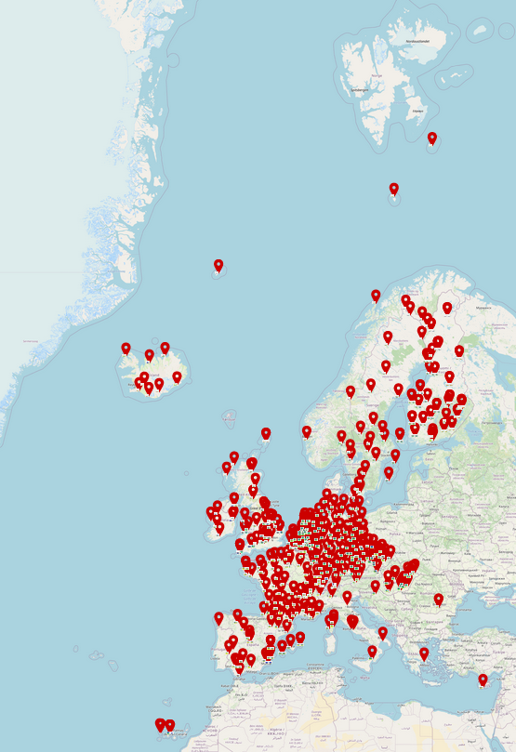
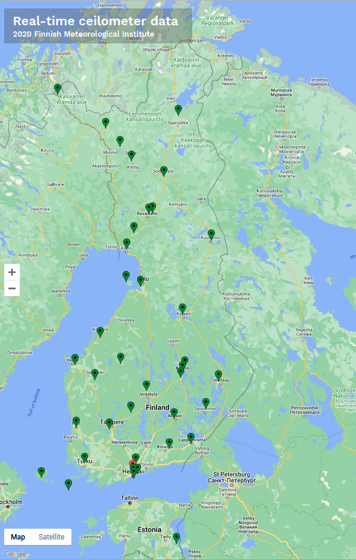
Ceilometer Network
Operational network
http://ceilometer.fmi.fi

Slide 20
Low cloud, fog, low visibility
Very important for airports
Need to start LVP (low visibility procedures)
VIS <= 600 m and/or ceiling <= 200 ft.
1 minute delay costs ~60-70€ for an airline
2014 data
Forecasting: challenging
Nowcasting?

Slide 21
Nowcasting of fog formation
In development at SIRTA, Paris

Slide 22
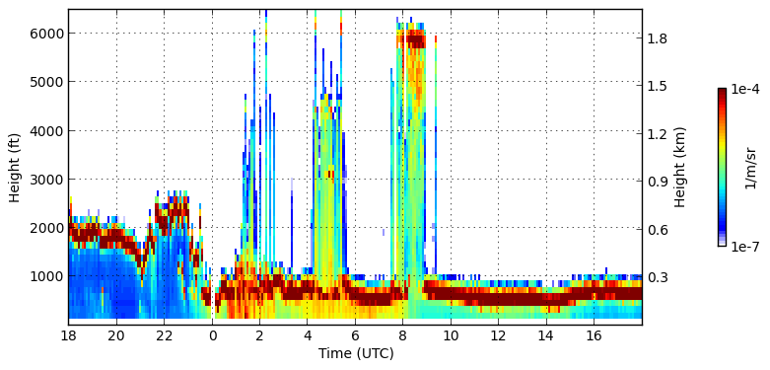
Supercoooled liquid layers - icing

Slide 23
Supercoooled liquid layers - icing

Slide 24
Supercoooled liquid layers - icing

Slide 25
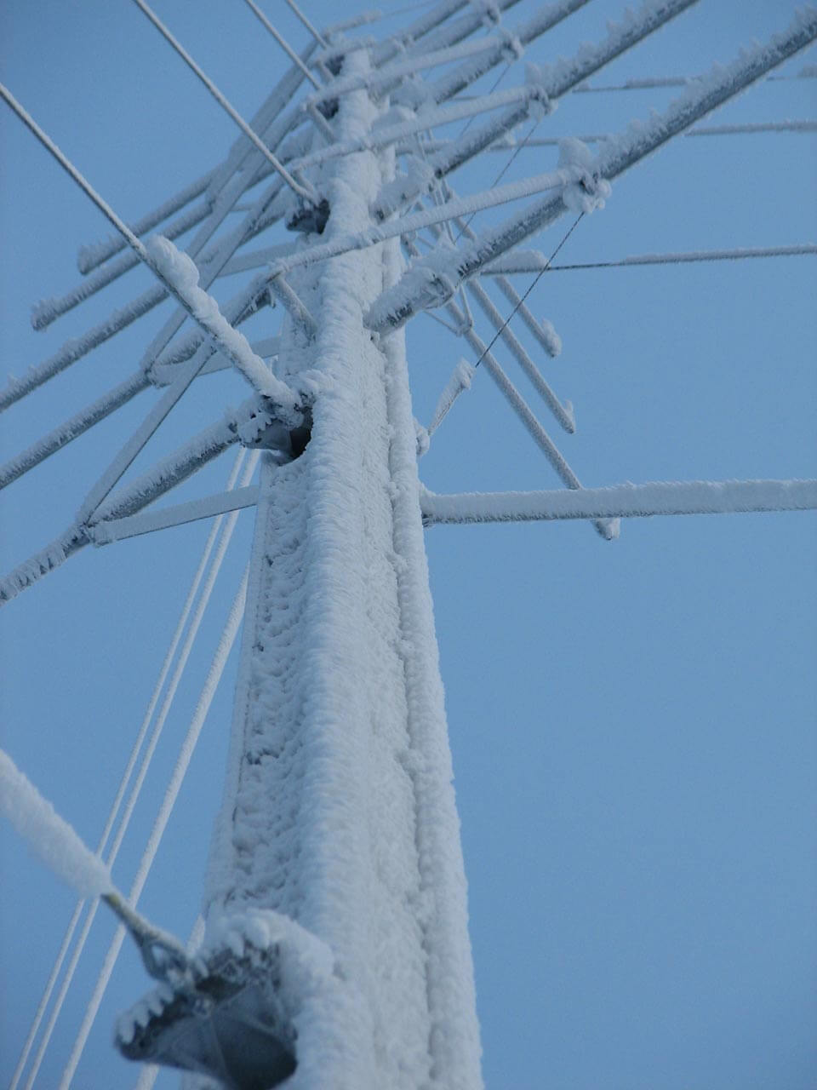
Supercoooled liquid layers - icing

Slide 26
Ceilometer network
Identify:
Liquid cloud base in multi-layer or deep cloud
Precipitation below cloud
Fog formation and dissipation
Supercooled liquid and icing potential
Nowcasting and forecasting applications
Most products can be made available in NRT

Slide 27
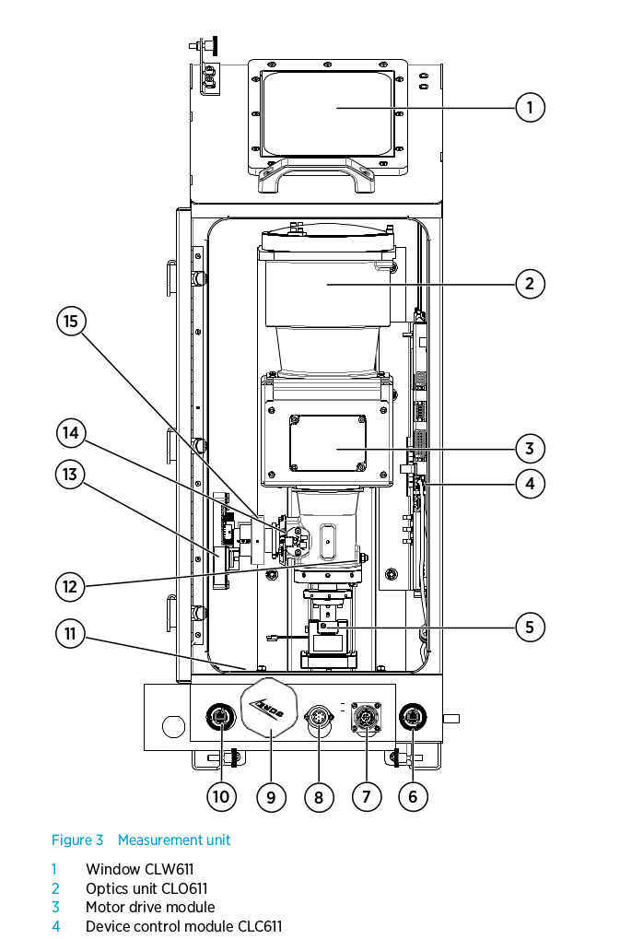
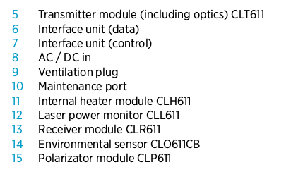
Vaisala CL61D

Slide 28
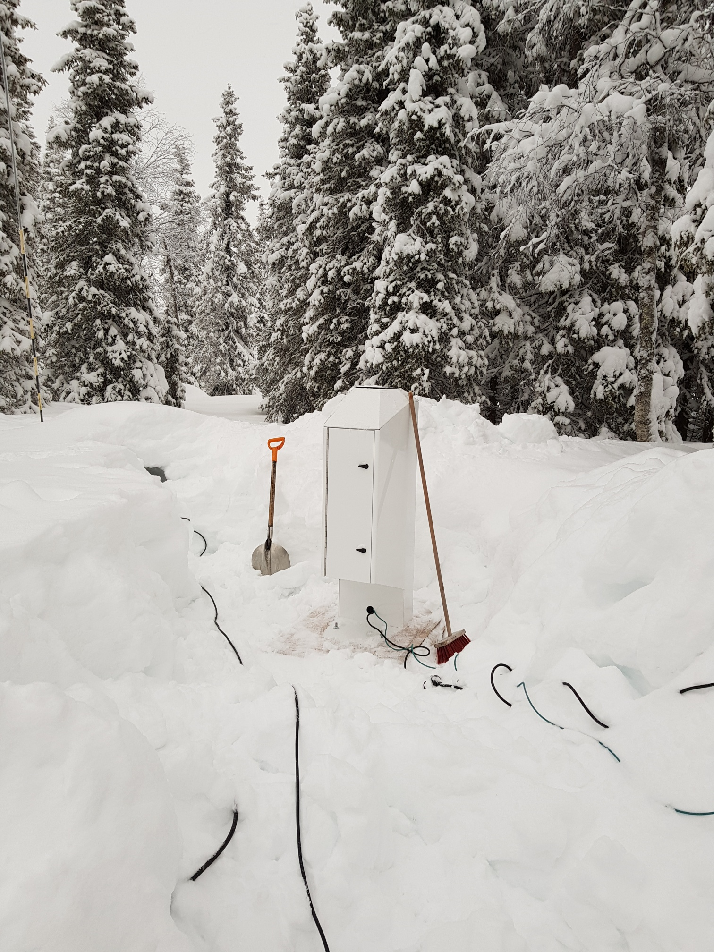
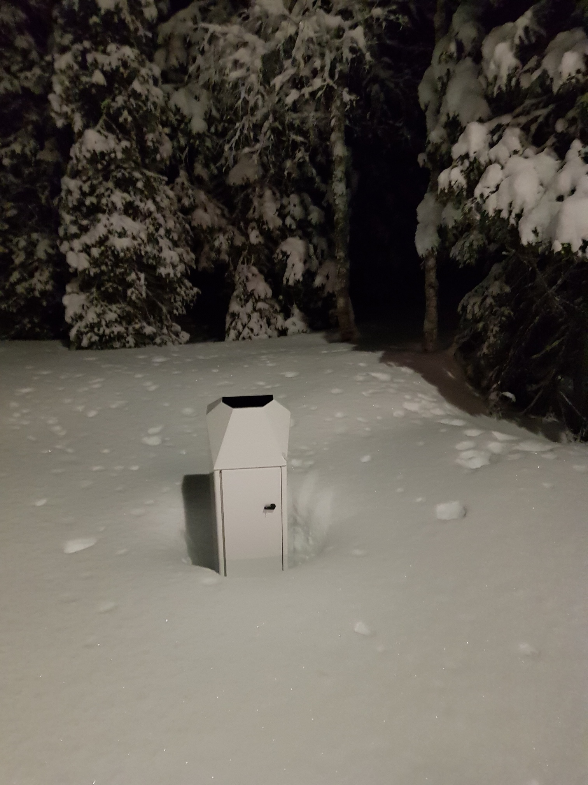
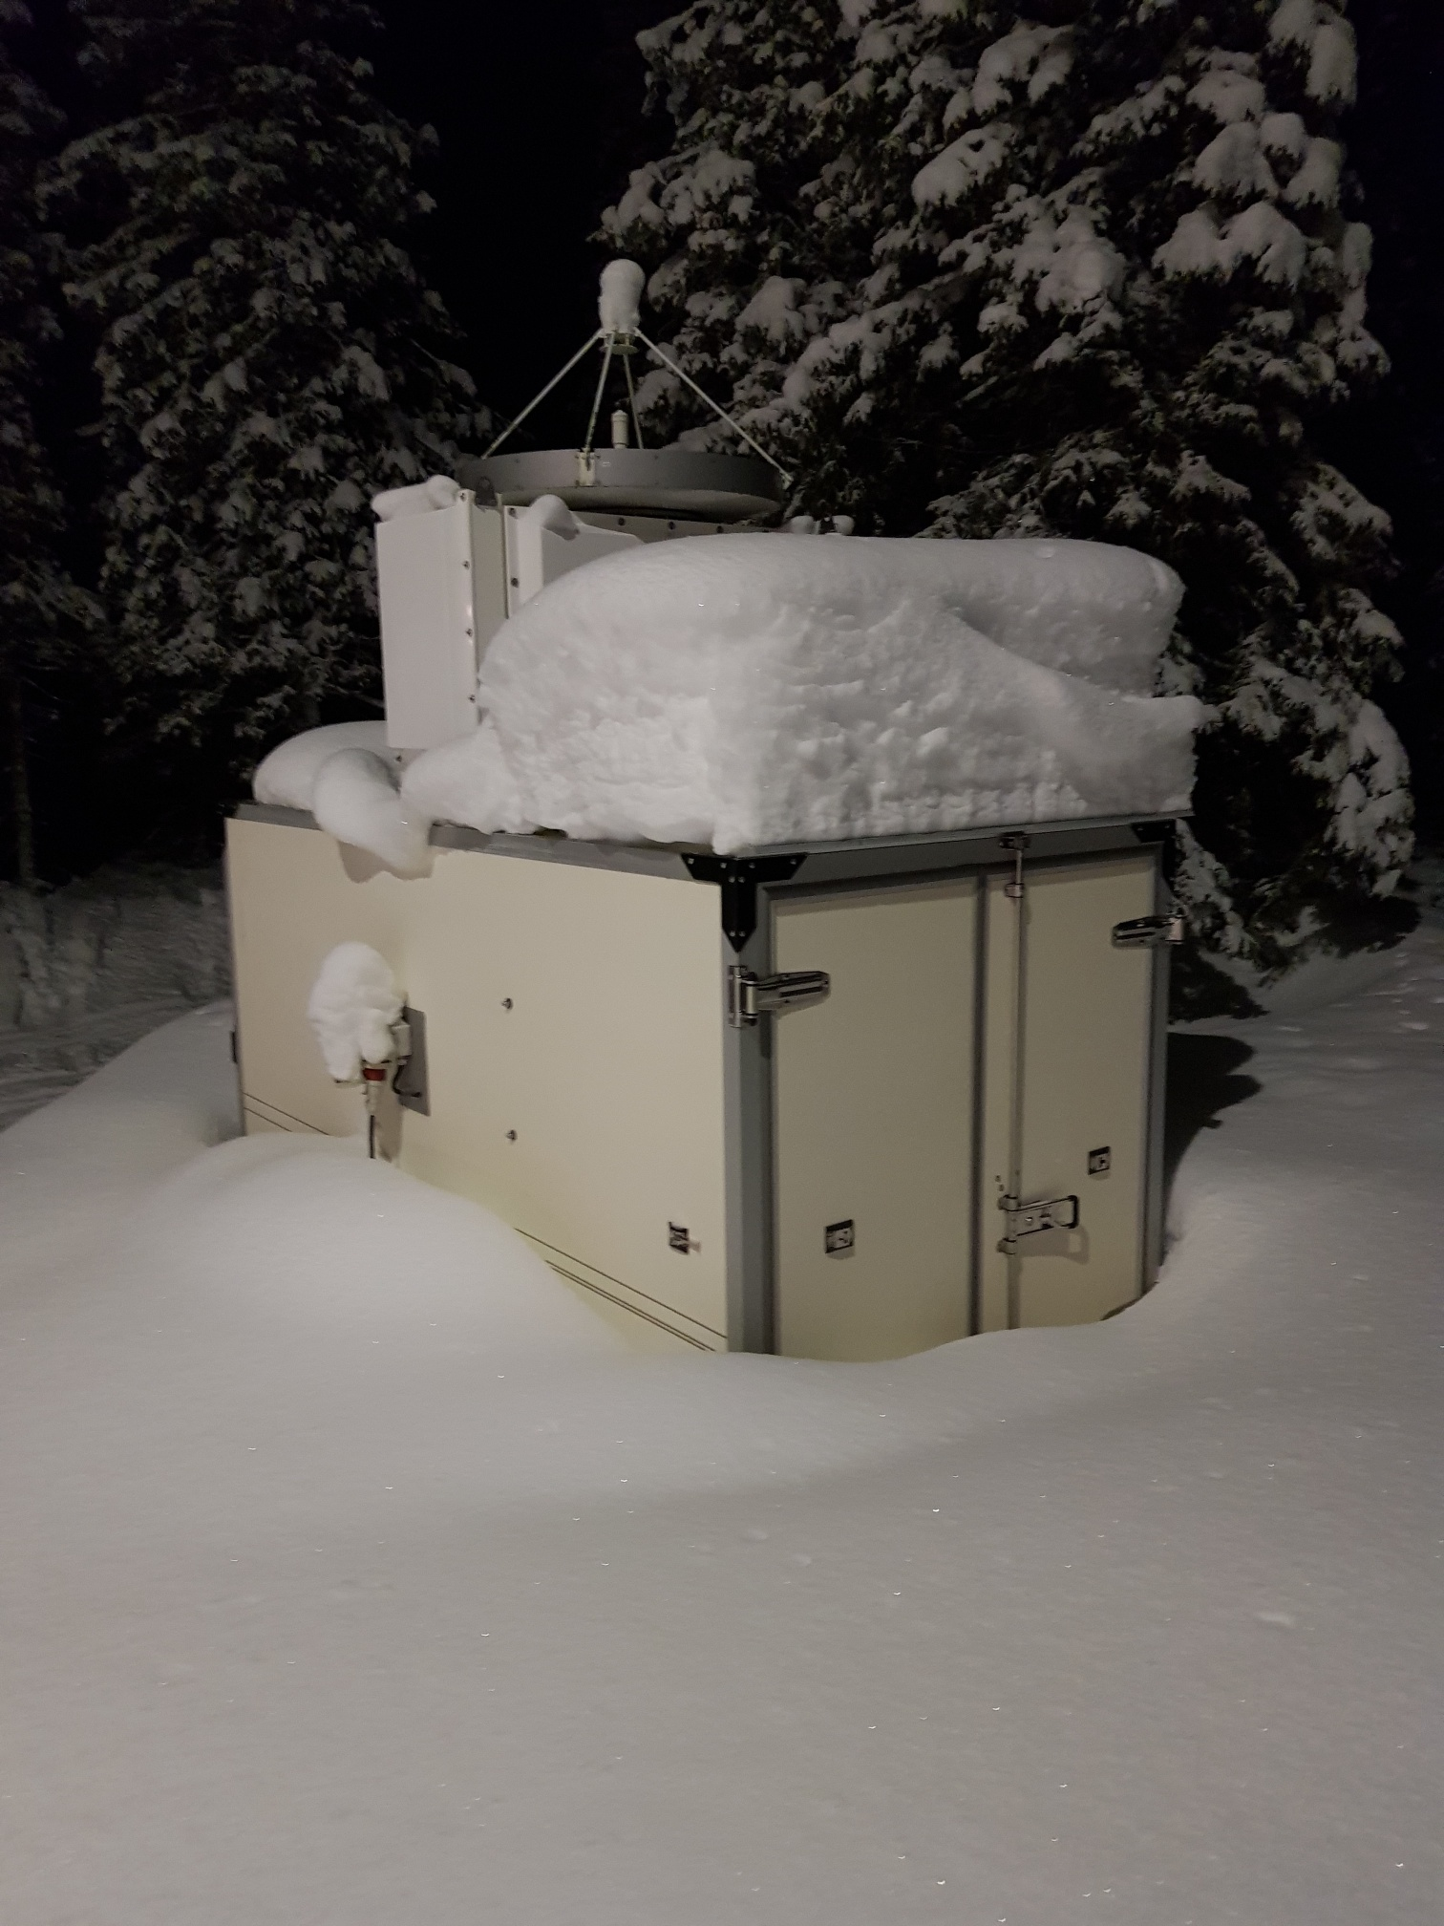
Test campaign - Kenttärova
Testing prototype – October 2019 to January 2020

Slide 29
Depolarisation
Transmit
Electromagnetic wave
Linear depolarisation
Receive
$$δ_{l}=\frac{P_{⊥}}{P_{‖}}=\frac{Perpendicular}{Parallel}$$

Slide 30
Simple explanation

Slide 31
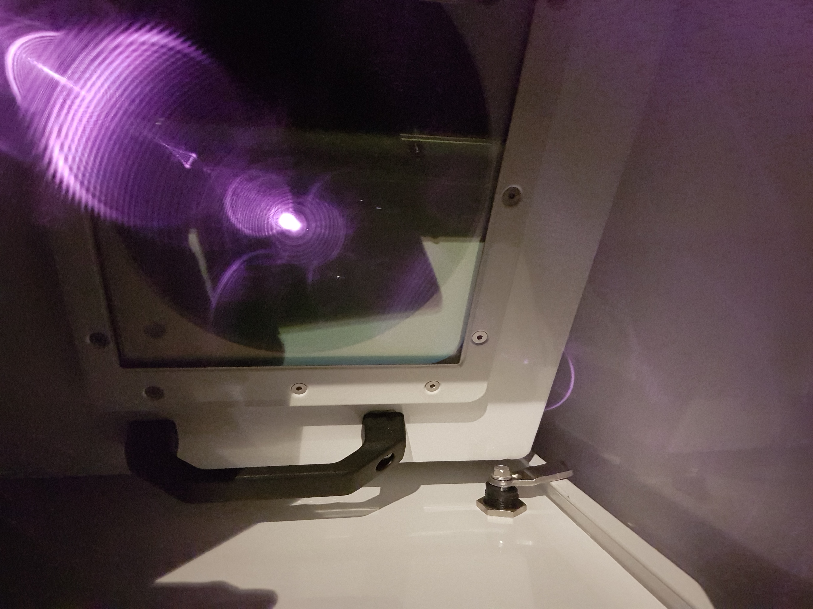
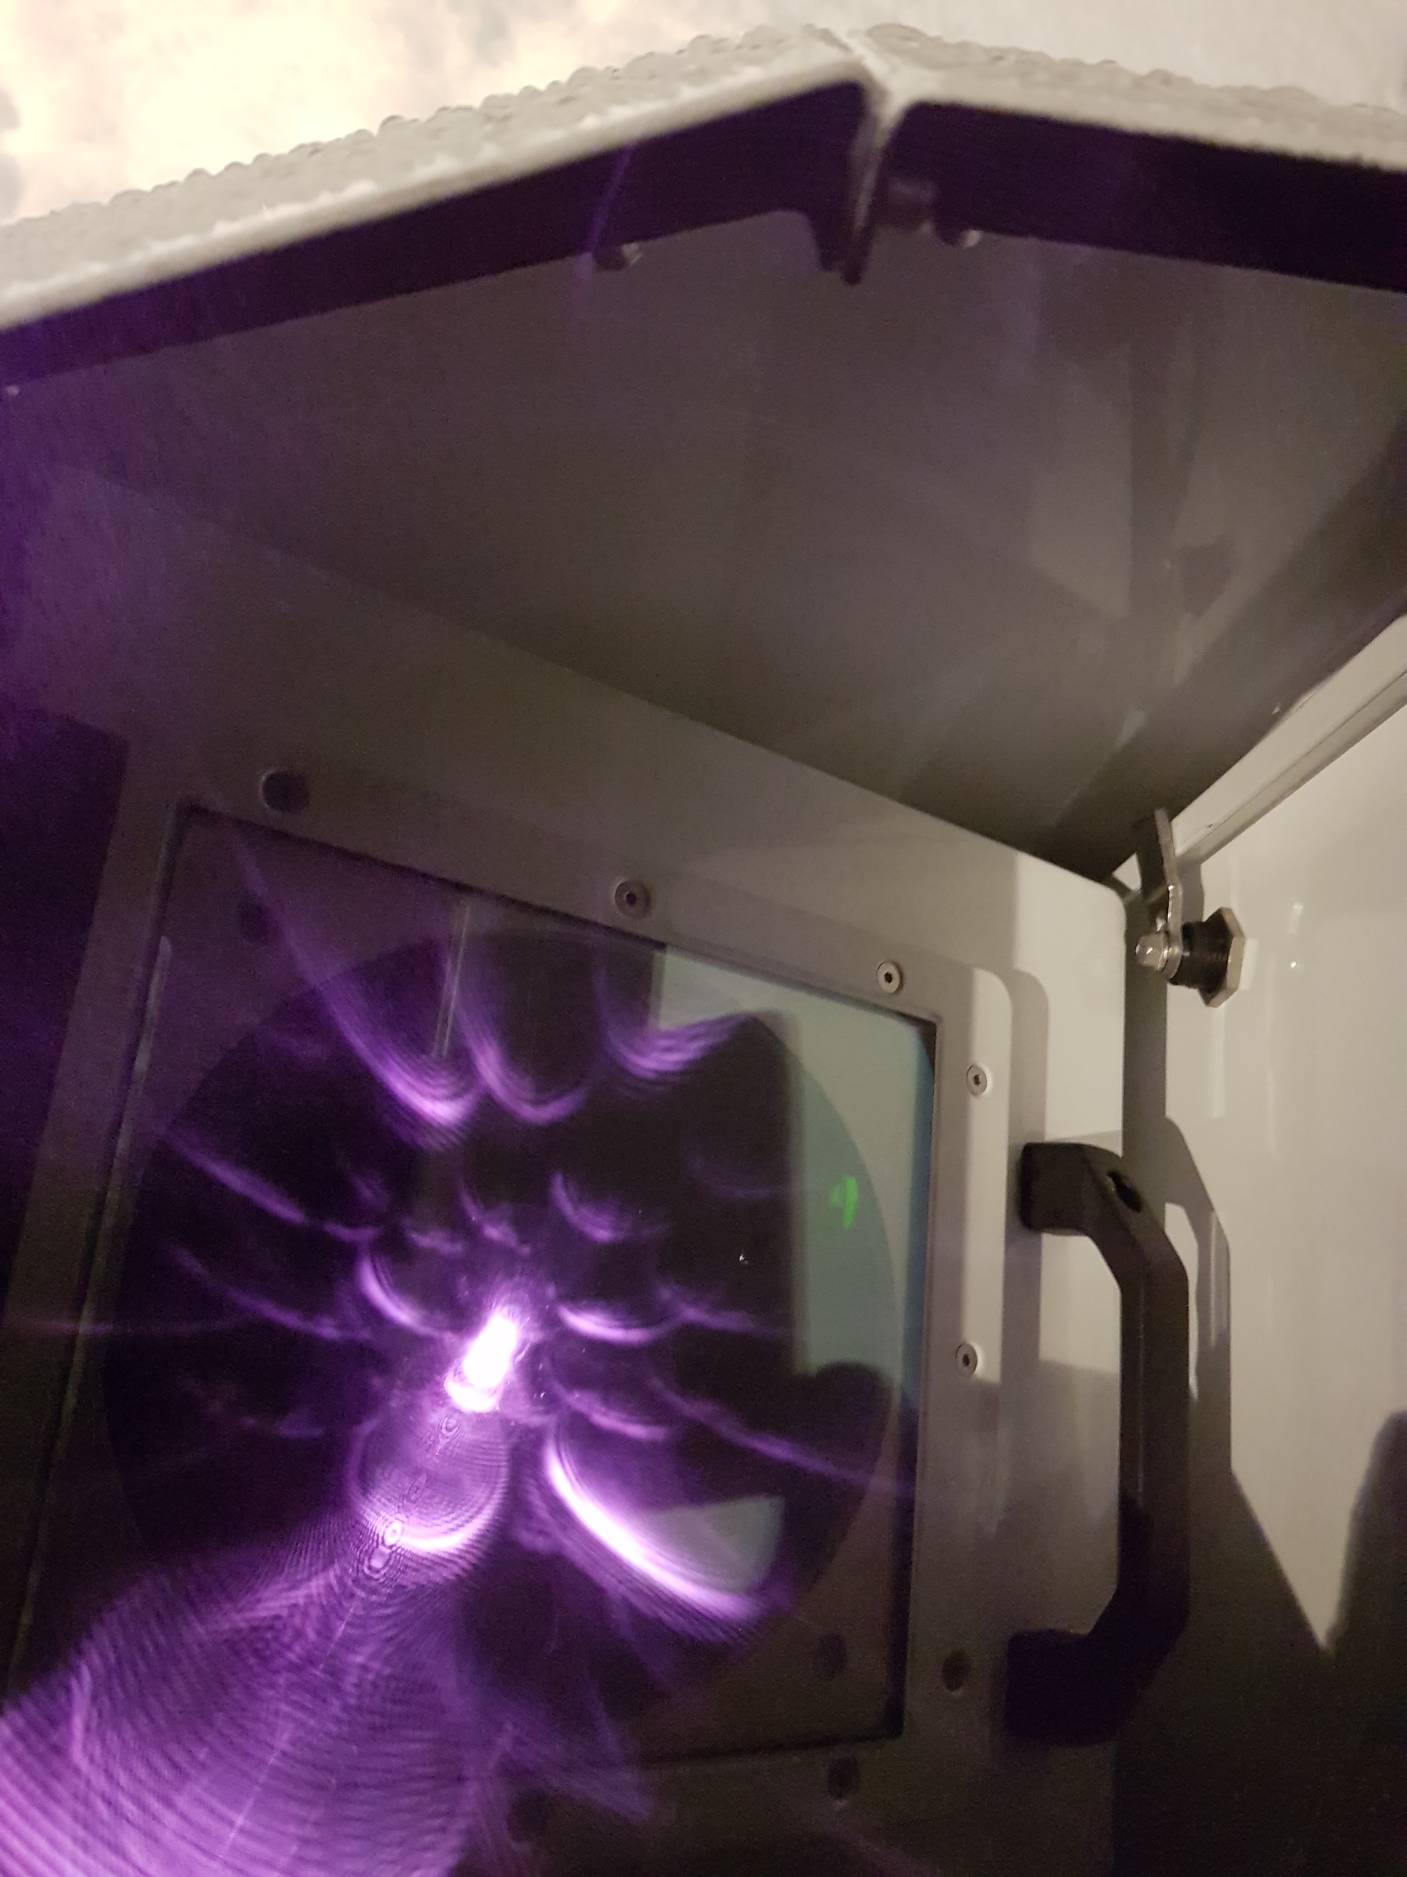
Test campaign - Kenttärova
Testing prototype – October 2019 to January 2020

Slide 32
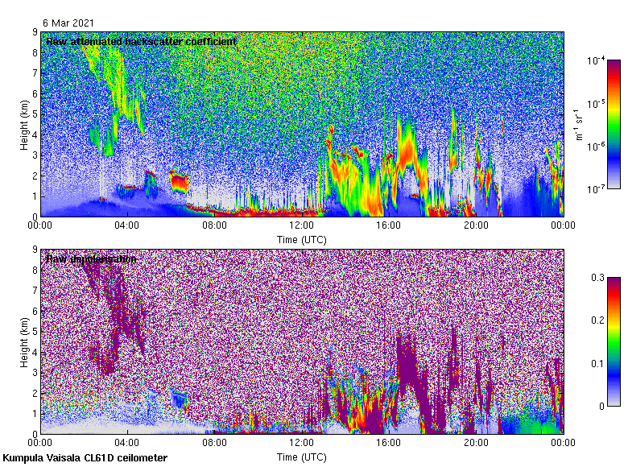
Examples

Slide 33
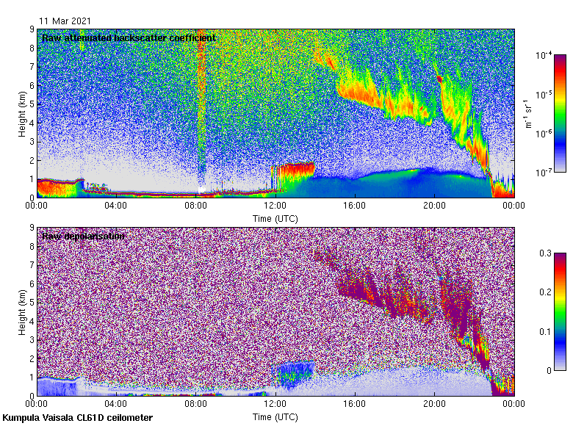
Liquid vs Ice

Slide 34
Liquid

Slide 35
Pollution

Slide 36
Road dust

Slide 37
Marine aerosol

Slide 38
Pollen

Slide 39
Pollen – sea breeze

Slide 40
Pollen - bad

Slide 41
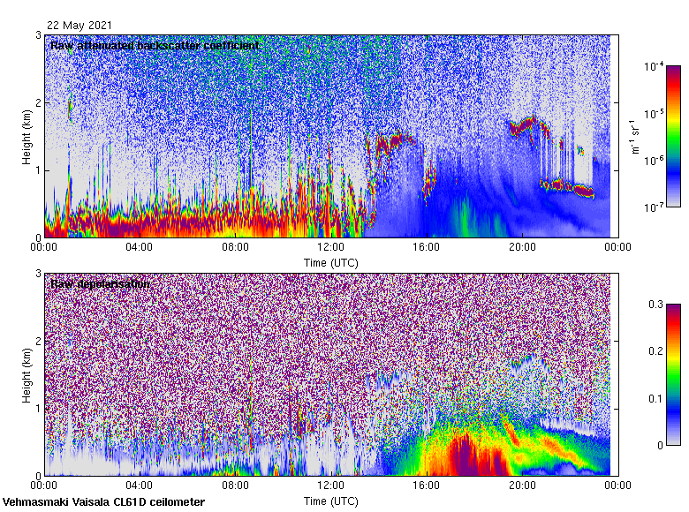
Pollen - Vehmäsmaki

Slide 42
Smoke - Kenttärova

Slide 43
Precipitation - snow

Slide 44
Precipitation - rain

Slide 45
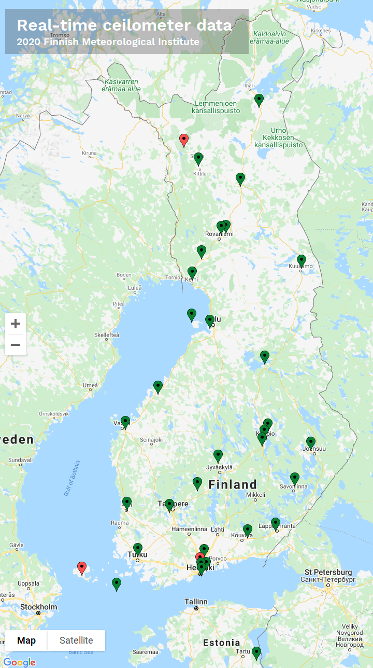
Network
Operational network
Joins ceilometer network
Locations
Vantaa
Vehmäsmaki
Rovaniemi
Kenttärova
Hyytiälä
Option to obtain more

Slide 46
Processing chain
HAVY network
S3 raw archive
Processing
ceilometer.fmi.fi
Images
SmartNet
Forecasters

Slide 47
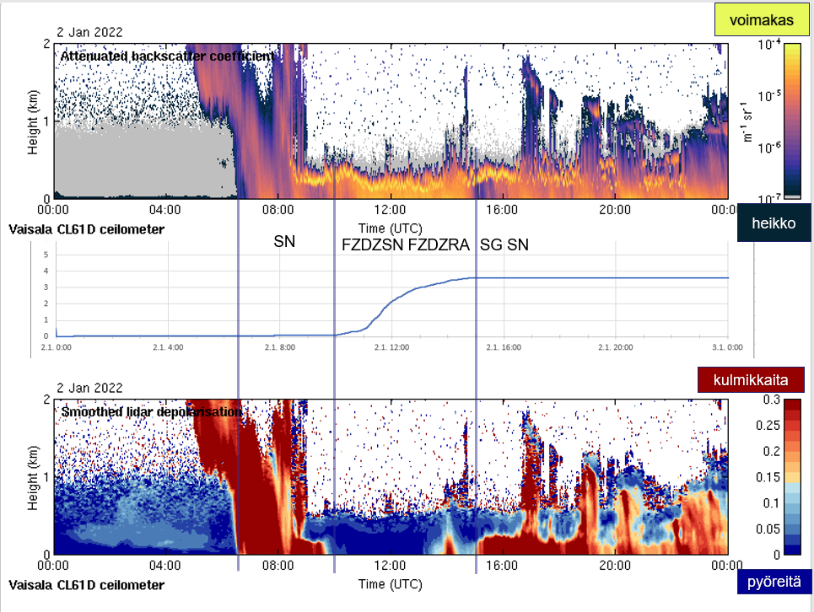
Precipitation – freezing rain/drizzle

Slide 48
Depolarisation improves ceilometer products
Easier to determine:
Water phase
Supercooled liquid vs ice
Snow vs rain (and melting transition)
Target diagnosis
Aerosol vs ice or precipitation
Specular reflection (misdiagnosis of supercooled liquid)
Products
Aerosol, cloud, precipitation classification
Identify presence of pollen, dust, smoke, volcanic ash

