Slide 1
Ground-based remote sensing of clouds

Slide 2
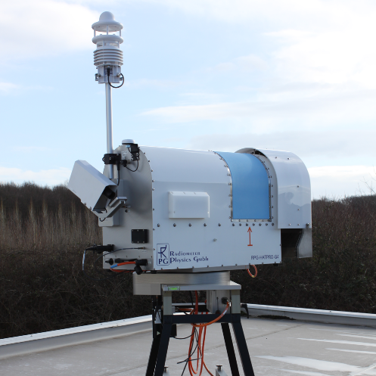
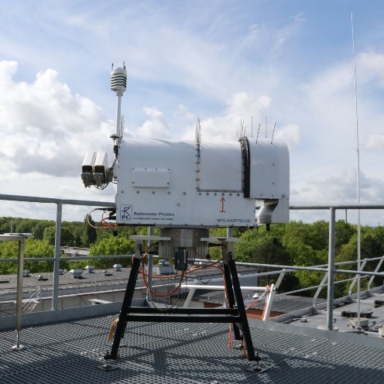
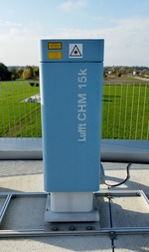
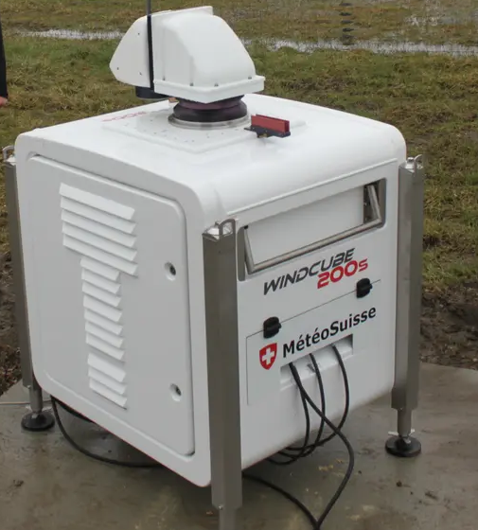
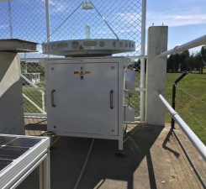
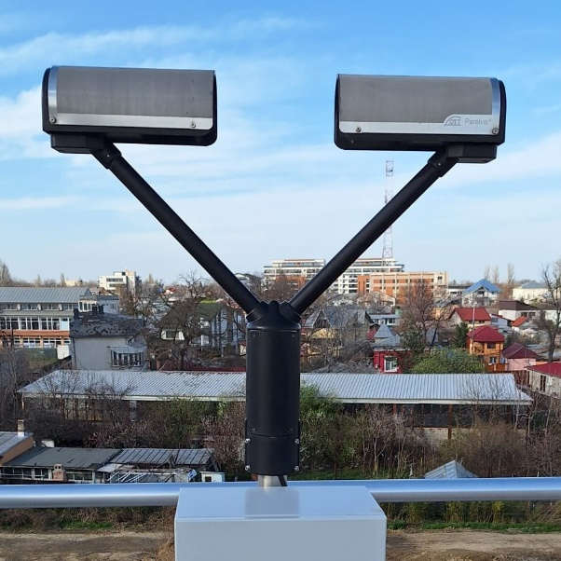
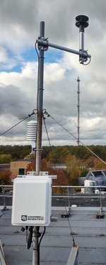
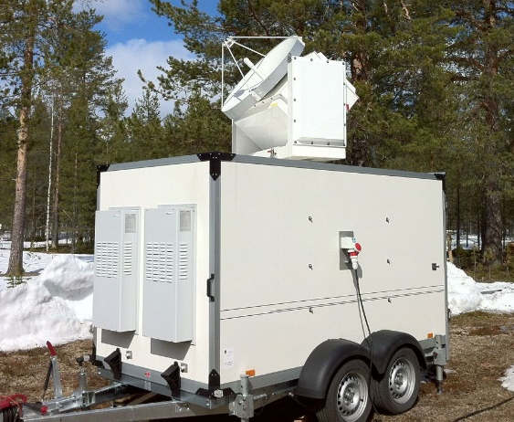
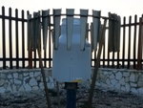
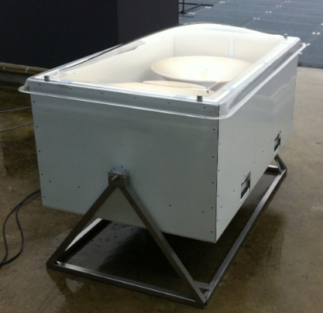
Ground-based cloud profiling
Notes:
Developer (database design and administration
- web development (full stack)
- development languages: mostly Java (with Spring-boot) and Javascript (VueJS), but also Python and PHP )

Slide 3
Evaluation of cloud microphysics in NWP and climate models using radar and lidar
Example of using cloud radar data to understand and improve NWP
Ice sublimation rate
Why do we need to combine radar and lidar?
Both are active instruments, but are sensitive to different moments of the size distribution
complementary
Vertical measurements for long-term microphysical studies
terminal velocity -> size
Formal framework for comparing models and observations
Introduce Cloudnet (now with ACTRIS)
Compare parameter of your choice
Provide skill scores (how good is your forecast!)

Slide 4
Ice sublimation rate
Study the cooling due to evaporation of hydrometeors
Dynamical impact of ice/snow potentially more important than rain due to high evaporation rate within a shallow layer
Relatively low fall velocity
Lower bulk density
Cooling rates of a few K m⁻¹ hr⁻¹
enhance slantwise convection
initiate vertical convection

Slide 5
Ice sublimation rate
Sublimation zone: gradient in IWC (calculated from Z)
Clear signature in:
Doppler velocity
Spectral width
Zone is also highly turbulent

Slide 6
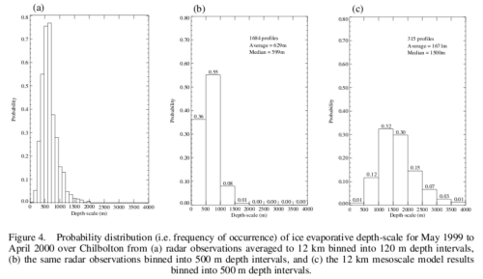
Ice sublimation rate
Reasons for discrepancy
Vertical resolution?
Ice microphysics?
Relative humidity?

Slide 7
Ice sublimation rate
1D model initialised with radiosonde profile of T, p, q
Similar sublimation depth to observed
Therefore, model microphysics correct
NWP model has same microphysics
Sublimation zone still too deep
Attributed to errors in RH

Slide 8
Ground-based cloud profiling
Notes:
Developer (database design and administration
- web development (full stack)
- development languages: mostly Java (with Spring-boot) and Javascript (VueJS), but also Python and PHP )

Slide 9
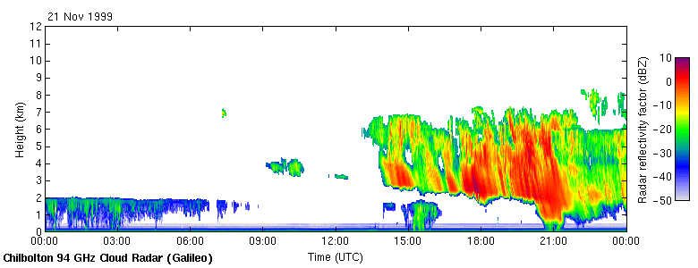
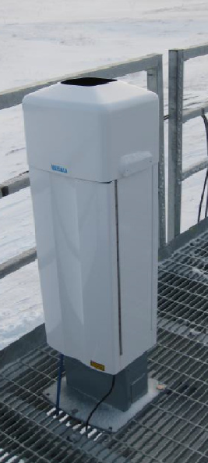
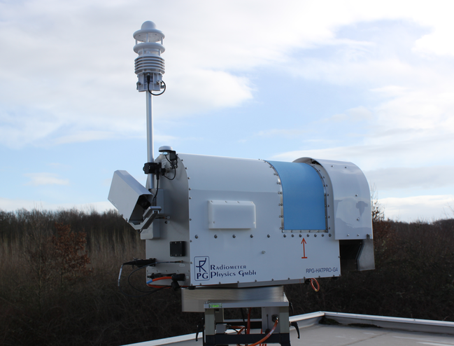
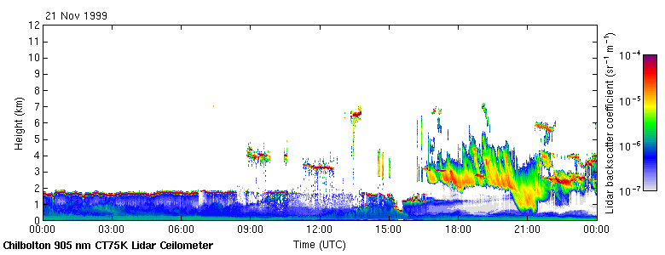
Ground-based remote sensing of clouds
Radar: Z~D⁶
Sensitive to large particles (ice, drizzle)
Lidar: β~D²
Sensitive to small particles (droplets, aerosol)
Penetrates ice cloud
Detects cloud top
Strong echo from liquid clouds
Detects cloud base

Slide 10
Terminal Fall Velocity (Beard et al., 1976)
For water spheres
Fall speed varies slightly with pressure and temperature
Aerosol: r~5e-7 m
Cloud: r~5e-6 m
Ice : r~2e-4 m

Slide 11
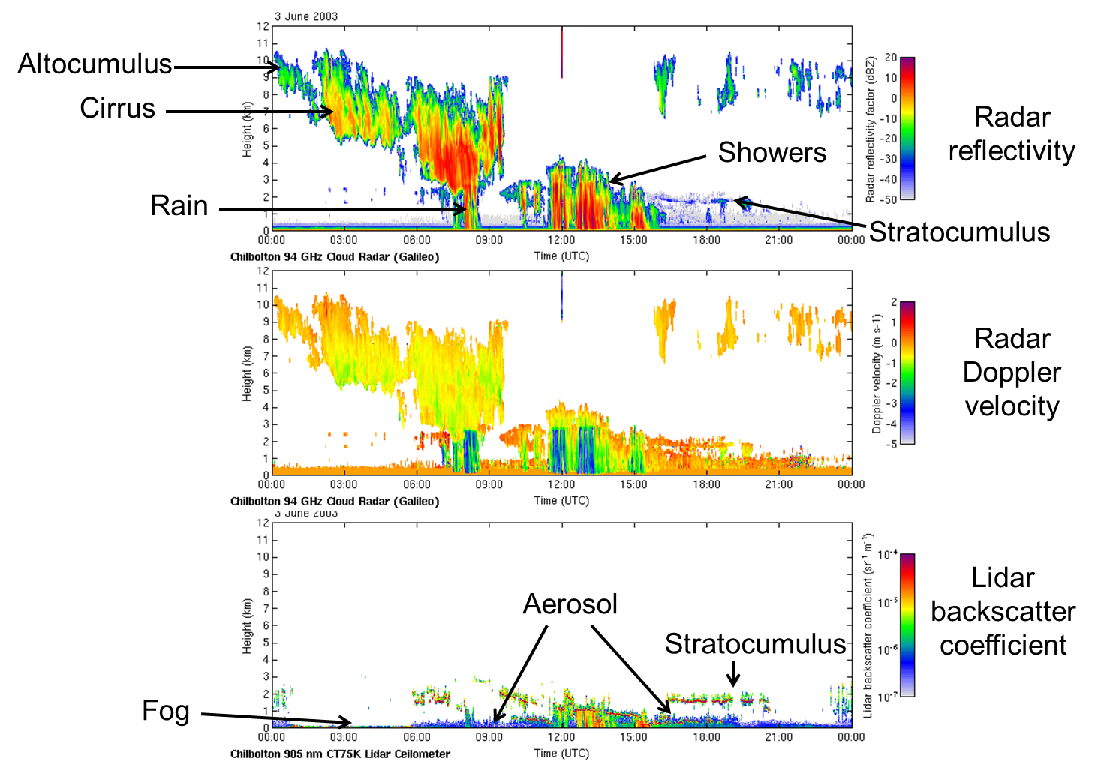
Notes:
Front passing over a vertically pointing radar and lidar
Showers produce negative Doppler velocity. Altocumulus and cirrus are not falling
Fog contains small water droplets, these attenuate the lidar so can’t ‘see’ altocumulus and cirrus
Lidar identifies stratocumulus better than radar because it has smaller particles

Slide 12
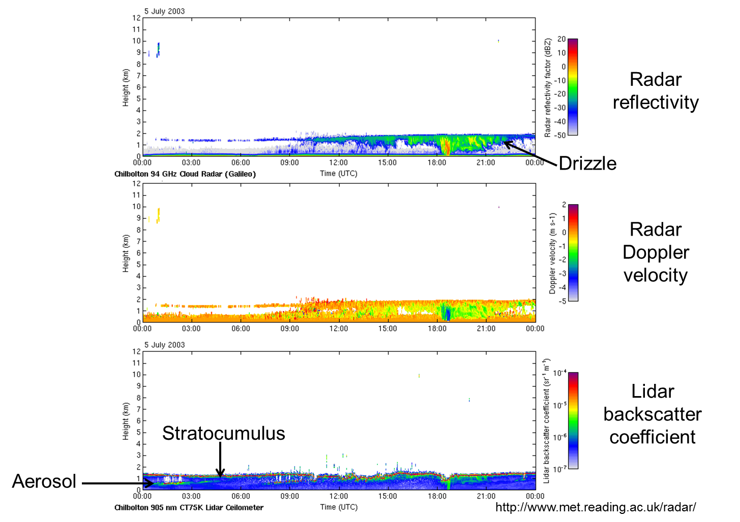
Notes:
Low level stratocumulus and drizzle
Not detected small droplets
Layer at 500m enhanced backscatter

Slide 13
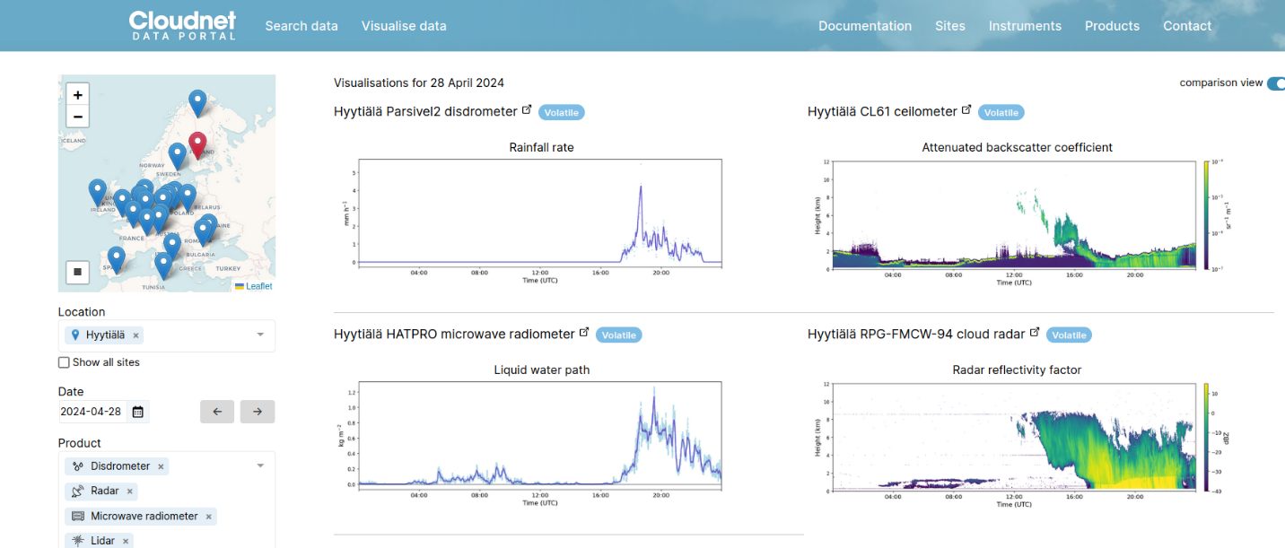
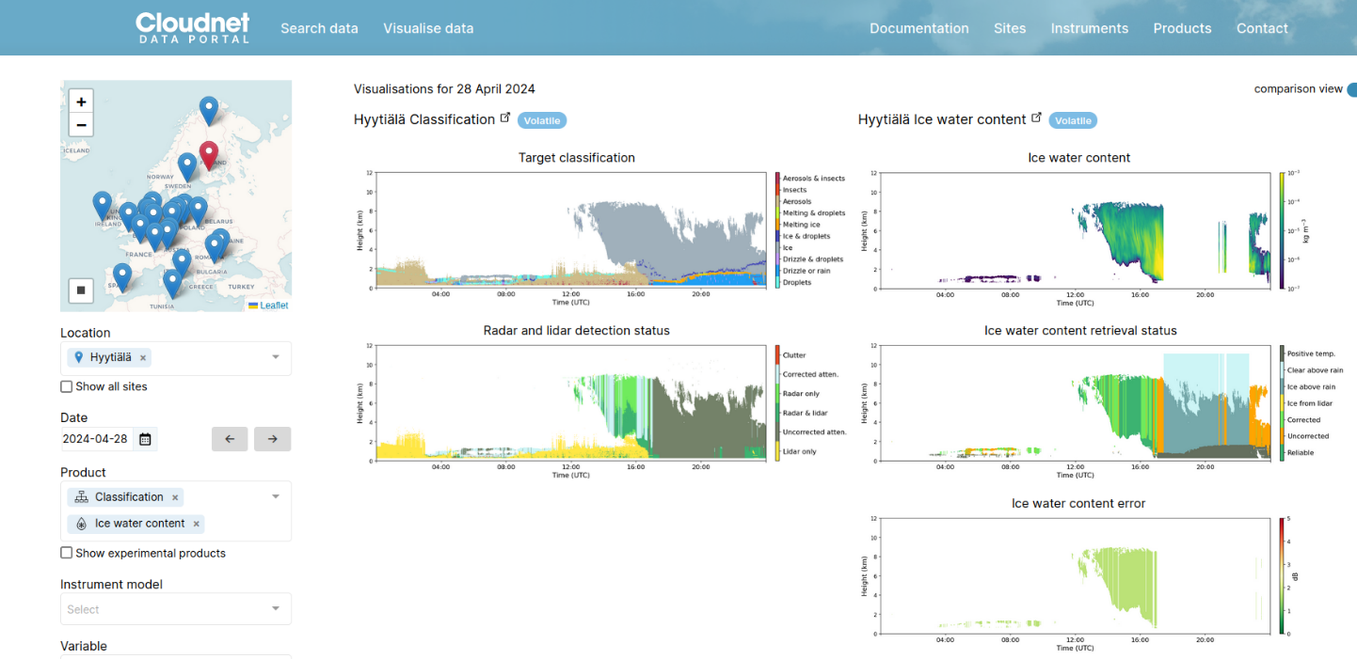
Ground-based cloud profiling
Notes:
Developer (database design and administration
- web development (full stack)
- development languages: mostly Java (with Spring-boot) and Javascript (VueJS), but also Python and PHP )

Slide 14
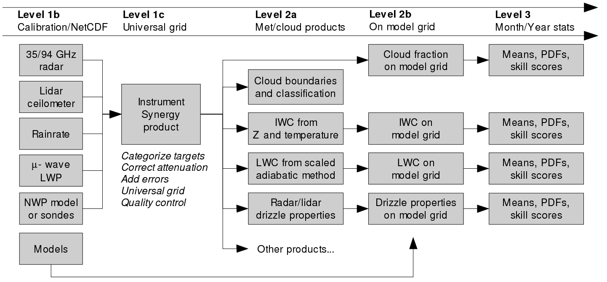
Original aim: to retrieve and evaluate the crucial cloud variables in forecast and climate models
8+ models: global, mesoscale and high-resolution forecast models
Variables: cloud fraction, LWC, IWC, plus a number of others
Sites: 10+ across Europe plus worldwide ARM sites
Period: several years to avoid unrepresentative case studies
Current status: characterise cloud properties
Funded by ACTRIS ERIC to apply to European sites

Slide 15
Level 1b
Minimum instrument requirements at each site
Cloud radar, lidar, microwave radiometer, rain gauge, model or sondes
Radar
Lidar

Slide 16
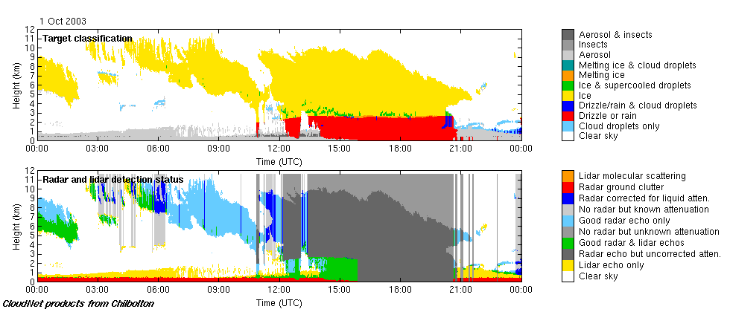
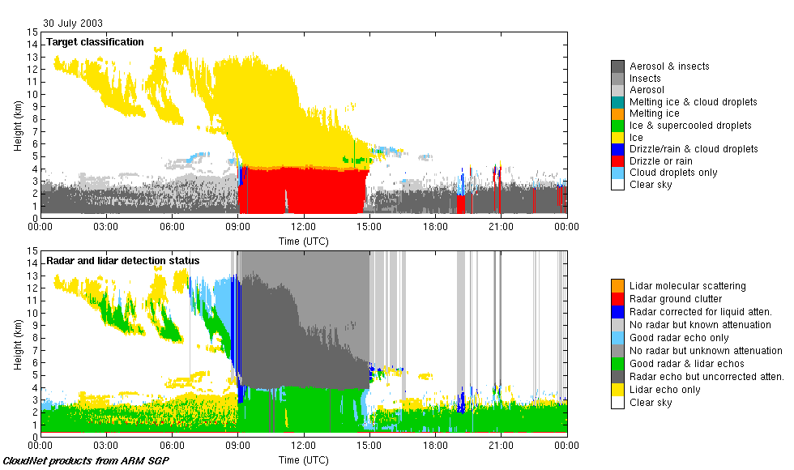
Level 1c
Instrument Synergy product
Example of target classification and data quality fields:
Ice
Liquid
Rain
Aerosol

Slide 17
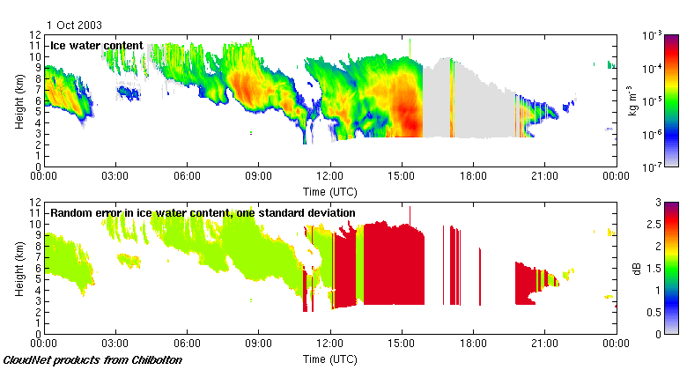
Level 2a
Ice water content (+errors) on observational grid
IWC from Z and temperature (Hogan et al. JAMC 2006)
Note larger error above melting-layer due to uncertain attenuation
IWC not reported if rain at ground

Slide 18
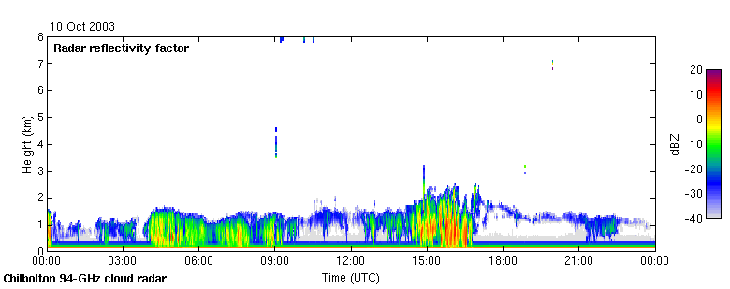
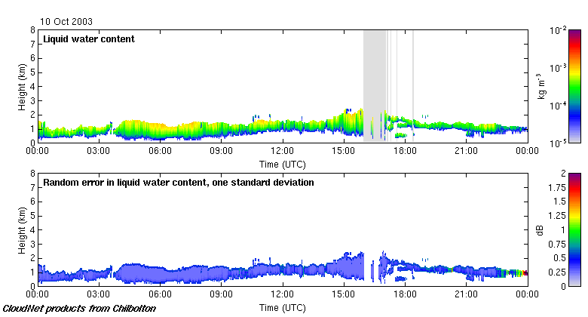
Level 2a
Liquid water content (+errors) on observational grid
“Scaled adiabatic” method (LWP +T + liquid cloud boundaries)
Reflectivity contains sporadic drizzle: not well related to LWC
LWC assumed constant or increasing with height has little effect on statistics

Slide 19
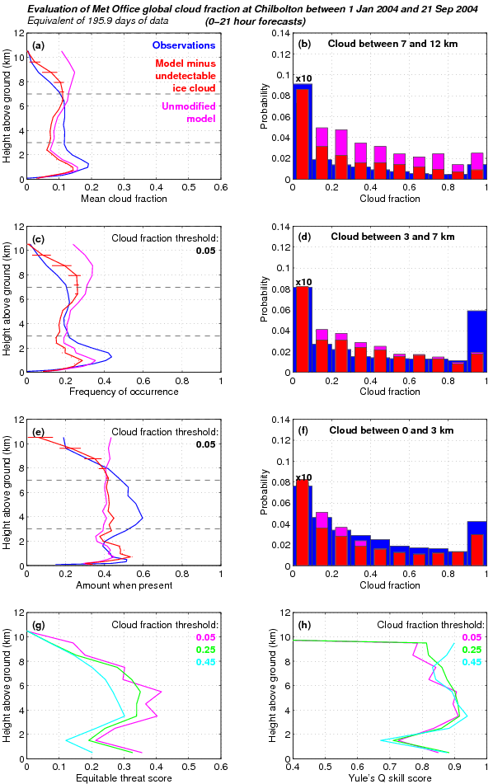
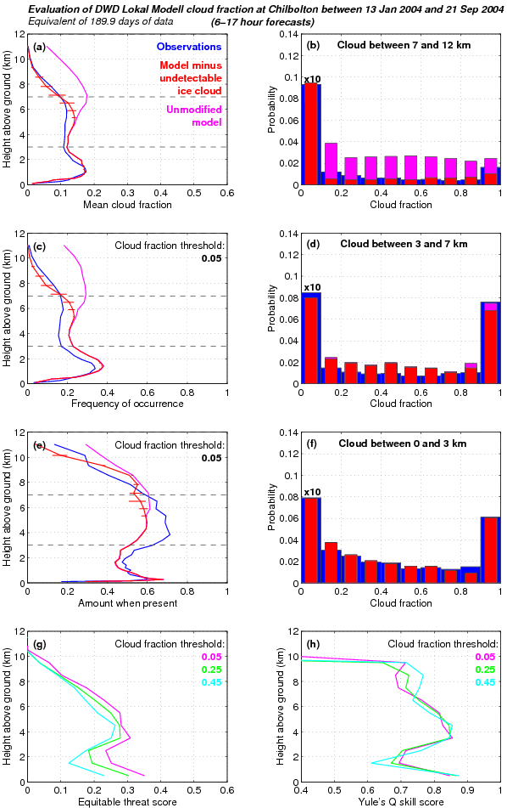
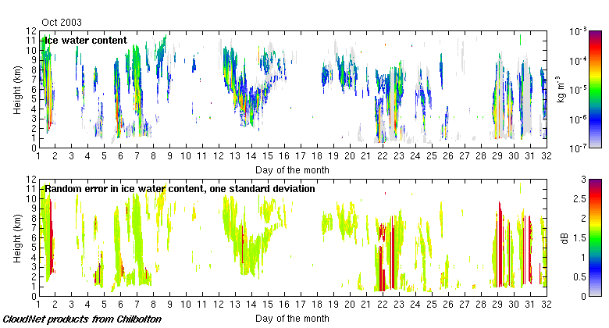
Level 2b
Variables on model grid
Averaged horizontally and vertically to grid of each model

Slide 22
Level 2a/2b
Cloud products on (L2a) observational and (L2b) model grid
Water content and cloud fraction
L2a IWC on radar/lidar grid
L2b Cloud fraction on model grid

Slide 23
Cloud fraction
Chilbolton
Observations
Met Office
Mesoscale Model
ECMWF
Global Model
Meteo-France
ARPEGE Model
KNMI
RACMO Model
Swedish RCA model

Slide 24
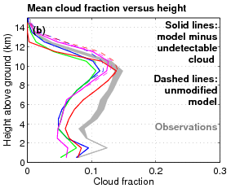
Cloud fraction at SGP
NCEP GFS 2007
NCEP GFS shows good agreement for Amount-When-Present
Problem is how often cloud is forecast

Slide 25
Cloud fraction in 7 models

Slide 26
A change to Meteo-France cloud scheme

Slide 27
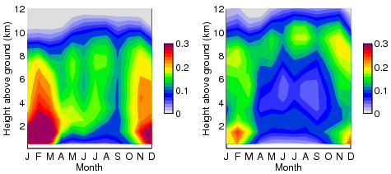
Composites: ECMWF, Lindenberg
Observation Model
Cloud fraction

Slide 28
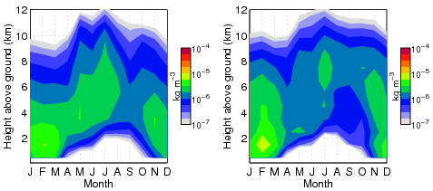
Composites: ECMWF, Lindenberg
Observation Model
Cloud fraction
Ice water content

Slide 29
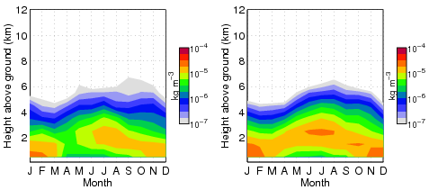
Composites: ECMWF, Lindenberg
Observation Model
Cloud fraction
Ice water content
Liquid water content

Slide 30
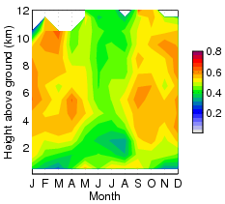
Composites: ECMWF, Lindenberg
Observation Model
Cloud fraction
Skill score SEDI

Slide 31
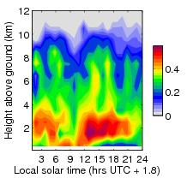
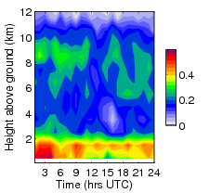
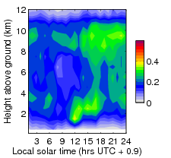
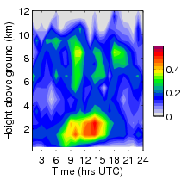
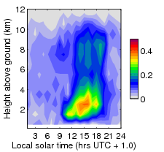
Diurnal composite of cloud fraction in summer
Sodankylä
Lindenberg
Mace Head
Chilbolton
Juelich
Leipzig
Potenza
Notes:
Provide a concise overview of the work done (technical review) since the beginning of the project until June 2013 with comparison to the original description of work in Annex I.
The progress of work should be summarized with respect to the content of the work (e.g., tasks) and not with respect to the deliverables.
In case of deviations from the original work plan please explain the reasons (incl. corrective actions).

Slide 32
Diurnal composite of cloud fraction in summer
Juelich
Sodankylä
Mace Head
Chilbolton
Lindenberg
Marine to Continental transition:
Less cloud
Enhanced daytime convection
Potenza
Marine
Continental
Notes:
Provide a concise overview of the work done (technical review) since the beginning of the project until June 2013 with comparison to the original description of work in Annex I.
The progress of work should be summarized with respect to the content of the work (e.g., tasks) and not with respect to the deliverables.
In case of deviations from the original work plan please explain the reasons (incl. corrective actions).

Slide 33
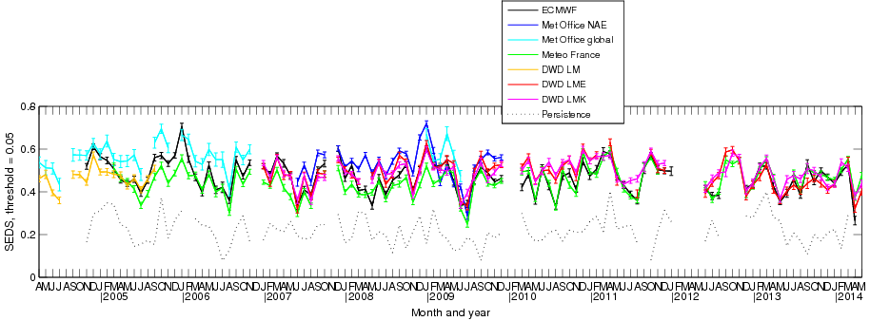
Decade of NWP forecast skill at Lindenberg

Slide 34
Forecast Lead-time
Model spin up
Assimilation preferred state

Slide 35
Forecast Lead-time
Model spin up
Assimilation preferred state
Model preferred state

Slide 36
Decade of forecast skill at SGP 2001-2010

Slide 37
Focus on Harmonie
3 stations in HARMONIE-AROME MetCoop domain:
Norunda, Sweden
Hyytiälä, Finland
Lindenberg, Germany
Observations
Model

Slide 38
Observation-model comparison – cloud fraction at Norunda
First identify if model has clouds in the right place at the right time:
use several months of observation and model data
compare cloud fraction
Then evaluate microphysics
Observations: all solid precipitation treated as ice – no separation into ice classes (e.g. snow, graupel)
Cloud fraction
If include model snow and graupel as cloud -> better agreement with observations

Slide 39
Observation-model comparison – ice water content – at Norunda
Mean ice water content also compares quite well at all levels, if snow and graupel included.

Slide 40
Observation-model comparison – ice water content – at Norunda
Might get the mean amount right but for the wrong reason. Can also calculate
frequency of occurence (how often do ice clouds occur),
and amount when present (what ice water contents do these clouds have)
Mean ice water content also compares quite well at all levels, if snow and graupel included.

Slide 41
Observation-model comparison – ice water content – at Norunda
Frequency of occurrence
Frequency of occurrence of ice above a low threshold amount too high once snow/graupel included
Not enough ice water content in mid level clouds
Close to surface: ice water content too high
Mean amount
Amount when present

Slide 42
Observation-model comparison – ice water content close to surface
Norunda
Hyytiälä
Lindenberg
Close to surface: ice water content too high
Robust signal at all stations – implication for model microphysics
Too much ice in graupel phase? Less time to sublime while falling?

Slide 43
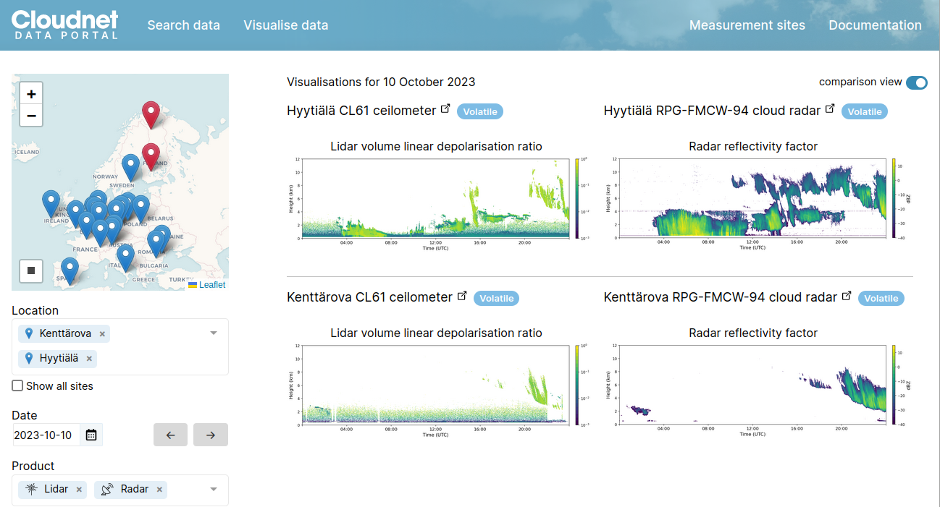
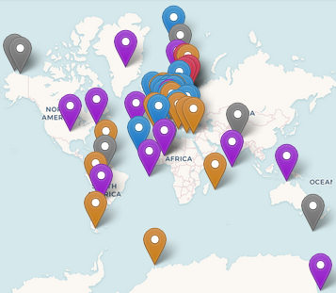
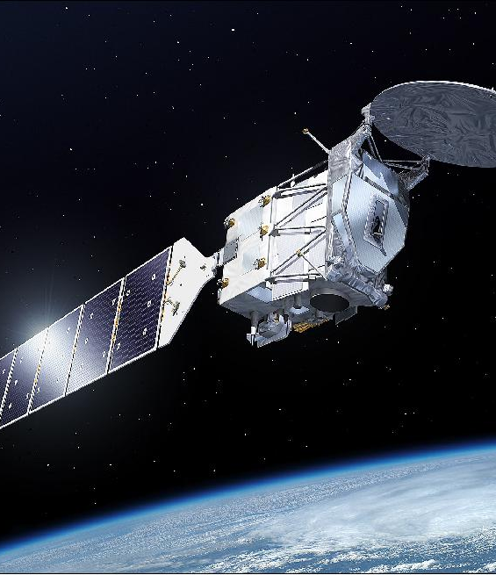
CLU: cloud profiling data portal
Characterisation and
processes
Juelich
Satellite Cal Val
https://cloudnet.fmi.fi
Model evaluation

Slide 44
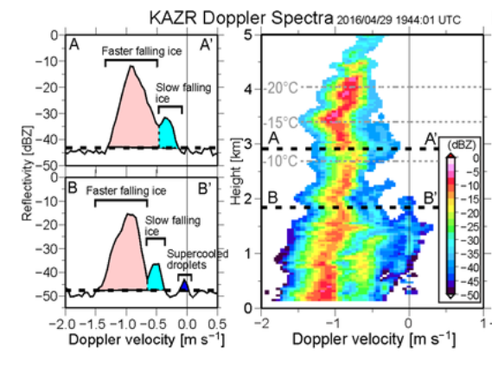
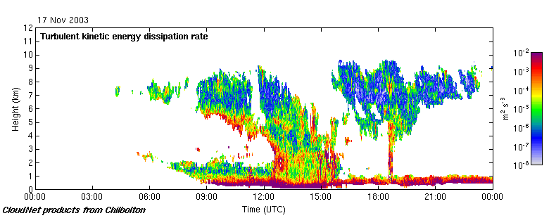
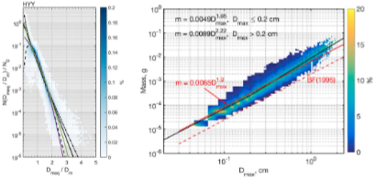
ACTRIS cloud profiling
Cloud microphysics: Doppler spectra, surface disdrometer
Multiple hydrometeor modes, phases in same volume
Vertical winds and turbulent properties:
Boundary layer and in-cloud (Radar and Doppler lidar)
Weak turbulence:
Cirrus
Strong turbulence
Evaporating ice
Stratocumulus
Boundary layer
dynamics
Identify vertical mixing and diagnose source
Size distributions, mass-density, particle shape
Evaluate satellite retrievals (e.g. cloud top height)

Slide 45
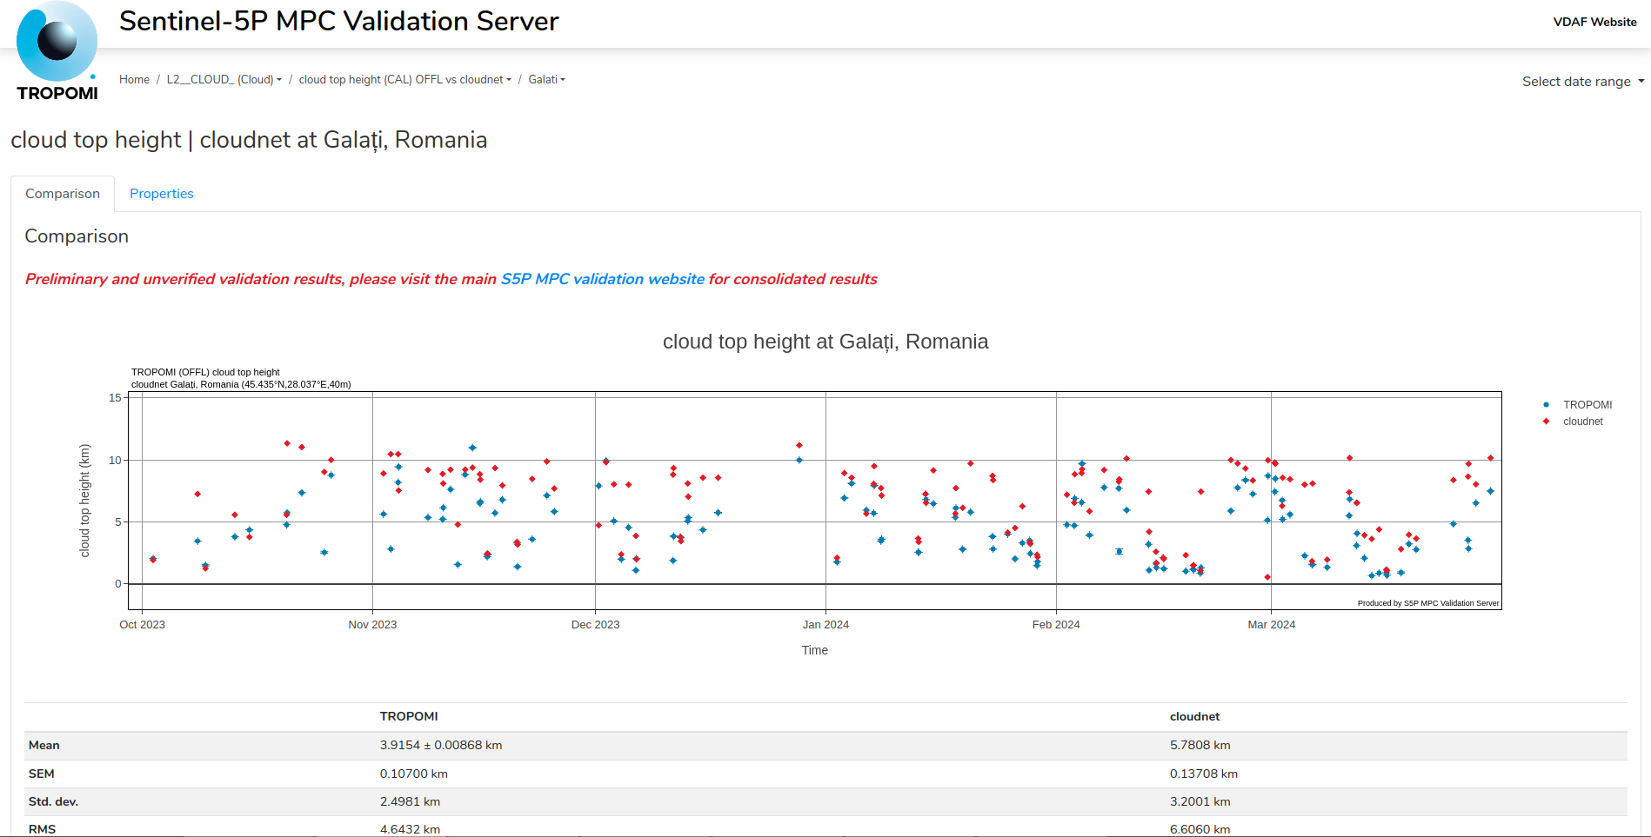

Slide 46
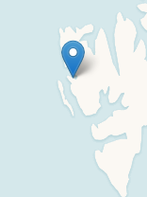
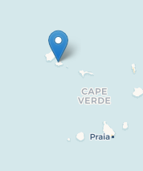
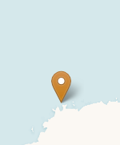
Ny Ålesund
Kenttärova
Hyytiälä
Cloud
fraction
EARTHCARE Cal/Val
Lindenberg
Cabauw
Chilbolton
Galati
Juelich
Palaiseau
Granada
Bucharest
Mindelo
Neumayer
Pilot for international stakeholders

Slide 47
Ground-based cloud profiling
Notes:
Developer (database design and administration
- web development (full stack)
- development languages: mostly Java (with Spring-boot) and Javascript (VueJS), but also Python and PHP )

Slide 48
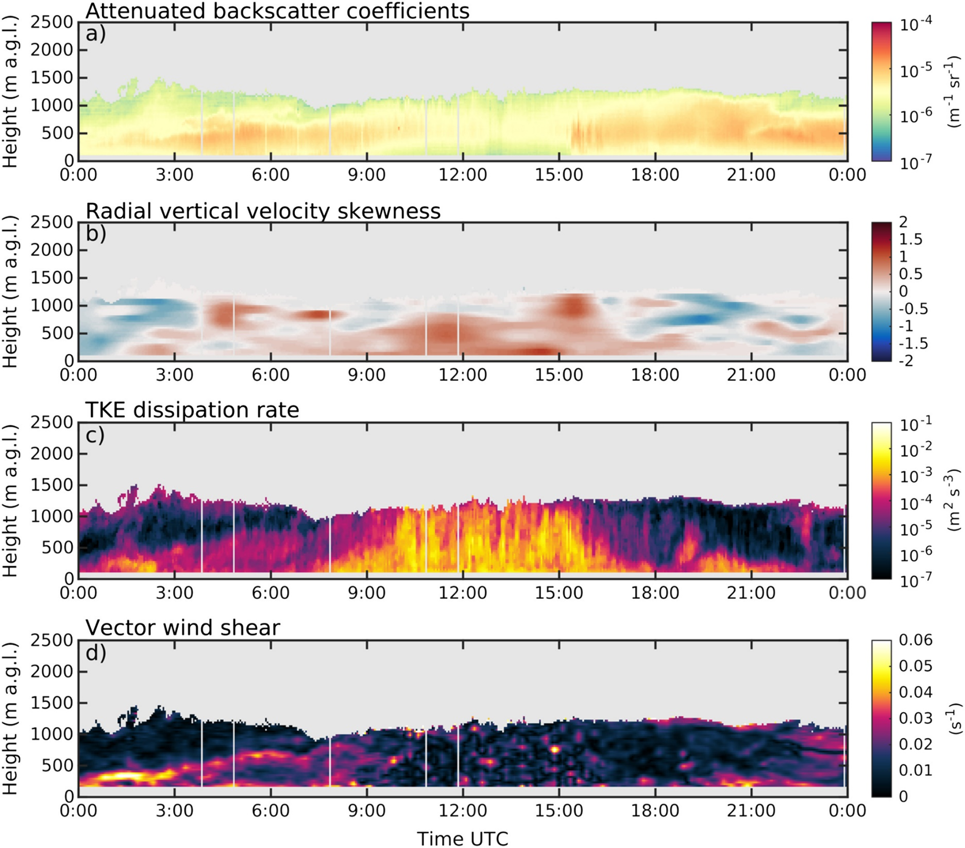

Slide 50
Boundary layer
Seasonal composite:
Juelich
height

Slide 52
Outlook
Multiple metrics for evaluating clouds in models
Cloudnet is implementing an evaluation interface
Large number of cloud profiling stations in Europe
5+ stations with >10 years of data
ACTRIS is funded for the long term
Opportunities for operational and project-based support

Slide 54
Level 2a
Liquid water content (+errors) on observational grid
“Scaled adiabatic” method (LWP +T + liquid cloud boundaries)
Reflectivity contains sporadic drizzle: not well related to LWC
LWC assumed constant or increasing with height has little effect on statistics

Slide 55
Liquid water content
Method of Albrecht et al. (1990), Boers et al. (2000)
Use lidar/radar to determine cloud boundaries
Assume linear increase of LWC with height
Scale LWC profile to match LWP from radiometers
Cloud top
(radar)
Height
Model
levels
Cloud base
(lidar)
LWC

Slide 56
Liquid water content
LWC not retrieved in rain

Slide 57
Liquid water content

Slide 58
Liquid water content

Slide 59
Liquid water content

Slide 60
Level 2a
Cloud products on observational grid
Includes both simple and complicated algorithms
Radar-lidar IWC (Donovan et al. 2000) is accurate but only works in the 10% of ice clouds detected by lidar
IWC from Z and T (Hogan et al. 2006) works almost all the time; comparison to radar-lidar method shows appreciable random error but low bias: use this to evaluate models

Slide 61
Level 2a
Ice water content (+errors) on observational grid
IWC from Z and temperature (Hogan et al., JAMC, 2006)
Note larger error above melting-layer due to uncertain attenuation
IWC not reported if rain at ground

Slide 62
Ice water content
Method of Hogan et al. (2006)
Using coordinated aircraft data (EUCREX) and 3 GHz scans
Fit to Z and
temperature
35 GHz

Slide 63
Ice water content
Method of Hogan et al. (2006)
Using coordinated aircraft data (EUCREX) and 3 GHz scans
Fit to Z and
temperature
94 GHz

Slide 64
Ice water content

Slide 65
Ice water content

Slide 66
Level 2b
Variables on model grid
Averaged horizontally and vertically to grid of each model

Slide 67
Drizzle below cloud
Doppler radar and lidar - 4 observables (O’Connor et al. 2005)
Radar/lidar ratio provides information on particle size

Slide 68
Drizzle below cloud
Doppler radar and lidar - 4 observables (O’Connor et al. 2005)
Radar/lidar ratio provides information on particle size
Retrieve three components of drizzle DSD (N, D, μ).
Can then calculate LWC, LWF and vertical air velocity, w.

Slide 69
Drizzle below cloud
Doppler radar and lidar - 4 observables (O’Connor et al. 2005)
Radar/lidar ratio provides information on particle size

Slide 71
Properties of various measures
Truly equitable
Asymptotically equitable
Not equitable

